Slide 1

CYBER SECURITY PROJECT

Slide 2
Content:
Vulnerability Assessment on Virtual Machine Metaspoiltable 2.
Vulnerability Assessment on Website testphp.vulnweb.com
Cracking password of zip file and cracking the hashes of given directory www.varunpathak.in/m1ss10n.zip
Hiding the video behind the image.

Slide 3
Vulnerability Assessment on Host Machine Metaspoiltable(2.0)

Slide 4
Vulnerability Statistic
RISK | NUMBER OF VULNERABILITY
HIGH | 12
MEDIUM | 5
LOW | 2

Slide 5
ISC BLIND Vulnerability
Observation:
We observed that the current machine is running on an older version of ISC BLIND(9.4.2). This version has high risk of exposure to security vulnerability which allow the unauthenticated access to attacker, which can trigger to remote code execution on targeted system.
RISK: |  | High |  | Medium |  |  | Low
A remote attacker can poison the remote DNS server by allowing the attacker to diveret legitimate traffic to arbitrary sites.
RECOMMENDATION:
Update the current version to blind to latest stable release. We recommend you to ensure continuous monitoring on the security patches and upgrades.
 |  |  |  |  | Affected Device:
.

Slide 6
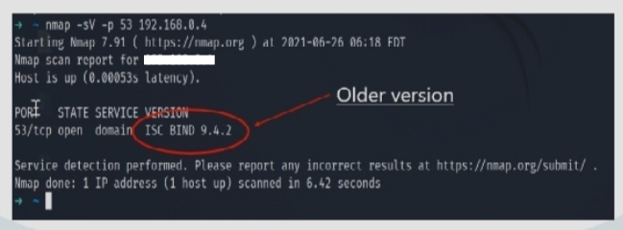
ISC BIND VULNERABILITY
Vulnerability Detection Report:try

Slide 7
X11 Unauthenticated Access
Observation:
We have observe that the system has the unauthenticated access which may lead to the severe problem because it must contain very sensitive data. It can accept connection from anywhere on an internet connection.
RISK: |  | High |  | Medium |  |  | Low
Cyber attacker can connect to server to eaves drop on keyboard and mouse of user utilising remote host. It is even possible for attacker to grap the screenshot of remote host and exploit malicious purpose . So they can get username and password.
RECOMMENDATION:
Restrict access to this port by using port by using the ‘XHOST’ command. If the X11 client/server facility is not used, disable TCP entirely.
 |  |  |  |  | AFFECTED DEVICE:
.

Slide 8
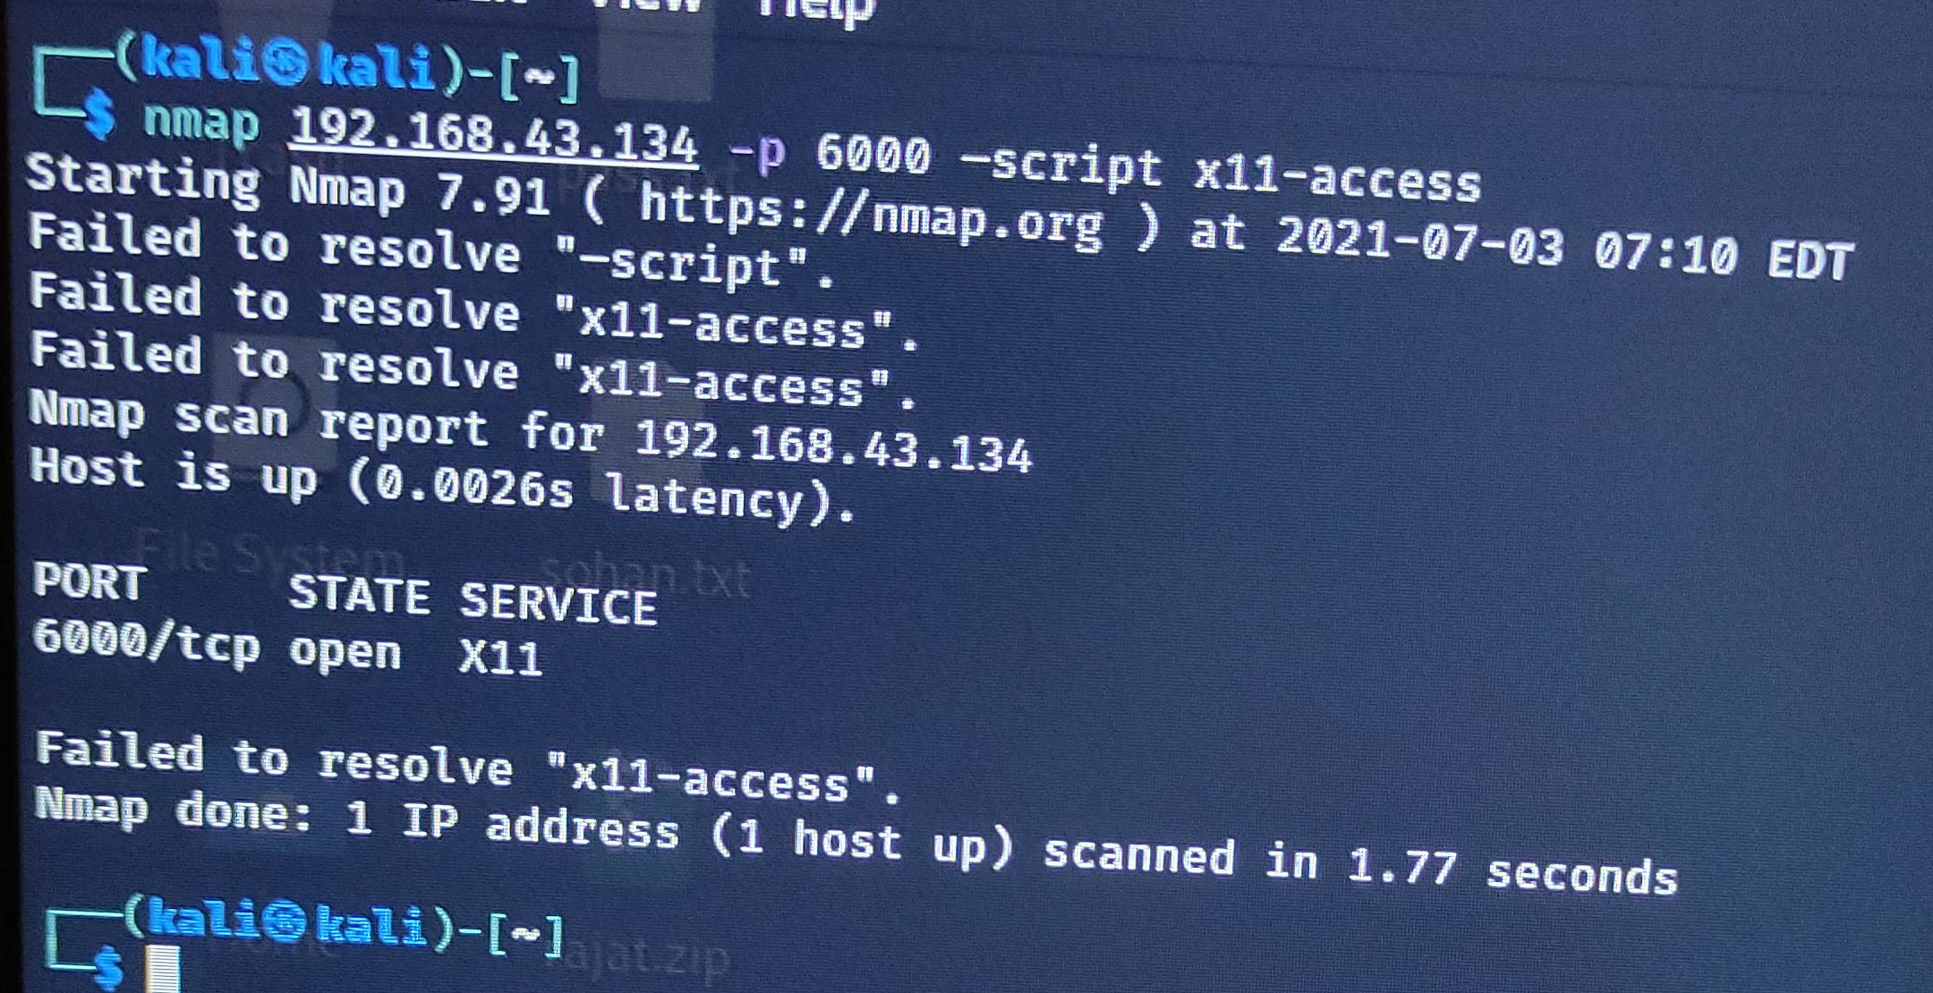
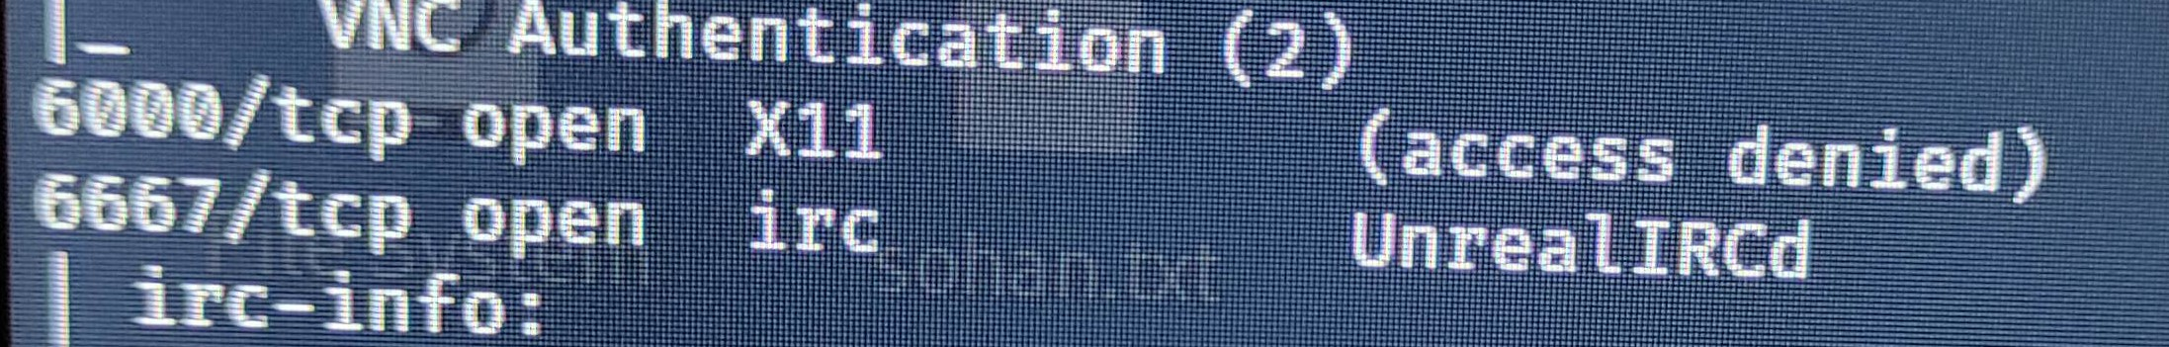
X11 Unauthenticated Access
Vulnerability Detection Report
Failed to resolve because access is denied.

Slide 9
Universal Plug and Play (UPnP)
Observation:
We have observe that due to the ability to control the Callback header value in the UPnP SUBSCRIBE function the vulnerability exist.
RISK: |  | High |  | Medium |  |  | Low
An attacker could utilize this vulnerability in the following scenarios: Send large amounts of traffic to arbitrary destinations. Exfiltrate sensitive device data by directing callback information to arbitrary targets. Intranet device port scanning to gather additional data from trusted assets within an organization’s LAN
RECOMMENDATION:
Disable the UPnP to fix the vulnerability.
 |  |  |  |  | AFFECTED DEVICE:
.

Slide 10
VNC AUTHENTICATION
Observation:
This VNC 1.0b1 is vulnerable to arbitrary file read, which leads to a compromise of the VNC server. The vulnerability exists even when authentication is turned on during the deployment of the VNC server. The password for authentication is stored in cleartext in a file that can be read via a ../../ThinVnc.ini directory traversal attack vector.
RISK: |  | High |  | Medium |  |  | Low
The VNC server installed on the remote host allows an attacker to connect to the remote host as no authentication is required to access this service.
RECOMMENDATION:
Disable VNC Server’s “No Authentication” security type
 |  |  |  |  | AFFECTED DEVICE:
.

Slide 11
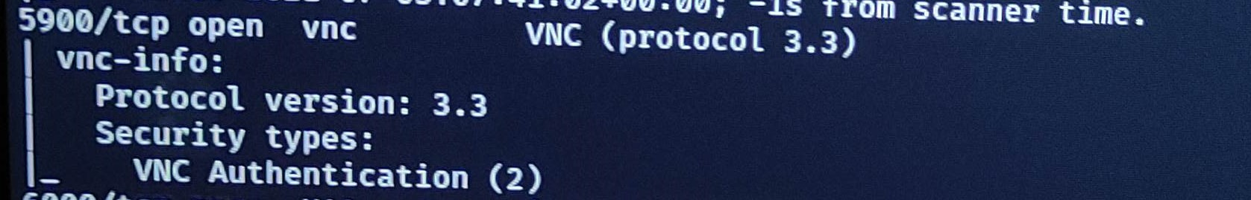
VNC AUTHENTICATION
Vulnerability Detection Report:
VNC version

Slide 12
NFS Exported Filesystems and Service
OBSERVATION:
The current machine is running on Network File System(NFS) server that enable the authorized and unauthorized user access to remote host and share files and directories.
RISK: |  | High |  | Medium |  |  | Low
It might lead to the discloser of information about your internal and network architecture. It also contain the valuable data leading to spoofing attack.
RECOMMENDATION:
Configure NFS on remote host so that only authorised host can mount its remote shares.
 |  |  |  |  | AFFECTED DEVICE:
.

Slide 13
Cross-Origin Resource Sharing(CORS)
Observation:
We have observed that CORS is vulnerable. The CORS policy allow the application to specify exception to the protection implemented by the browser, and enable the developer to specify allow listed for which external JavaScript is permitted to execute and interact with page.
RISK: |  | High |  | Medium |  |  | Low
This allows remote attackers to discover host information, nodes, API metadata, and references to usernames api/v1/apikey.
RECOMMENDATION:
Proper configuration of cross-domain requests Only allow trusted sites Avoid wildcards in internal networks Avoid whitelisting null
 |  |  |  |  | AFFECTED DEVICE:
.

Slide 14
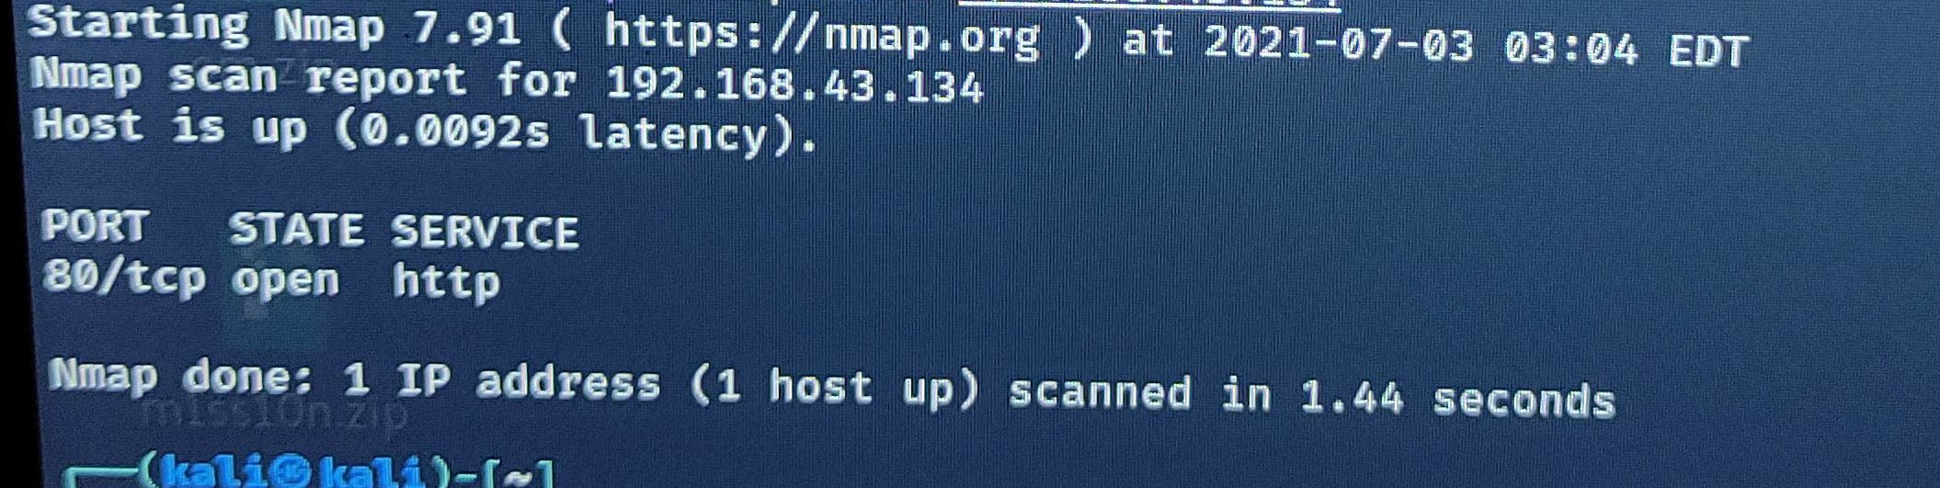
Cross-Origin Resource Sharing(CORS)
We can exploit the CORS vulnerability in following way:
For example ,consider the following request:
GET /api/userinfo.php Host: www.victim.com Origin: www.victim.com
When you send the above request, you get a response with the Access-Control-Allow-Origin header setting.
HTTP/1.0 200 OK Access-Control-Allow-Origin: * Access-Control-Allow-Credentials: true
In this example case, the header is configured with a wildcard(*). It means any domain can access the resources.
VULNERABLE

Slide 15
SSH Server Host-key Too Small
Observation:
The SSH protocol (Secure Shell) is a method to secure remote login from one computer to another. The SSH Server is using a small public key where the RSA is 2048 bits and DSA is 1024 bits which can lead to attack on machine.
RISK: |  | High |  | Medium |  |  | Low
There is high chances of Man in the Middle Attacker(MITM) where the attacker can exploit the machine to record the communication and to decrypt the session key and even the message.
RECOMMENDATION:
It is recommended to install the RSA public key of length 4096 bits and remove the DSA public key to forbidden such attack.
 |  |  |  |  | AFFECTED DEVICE:
.

Slide 16
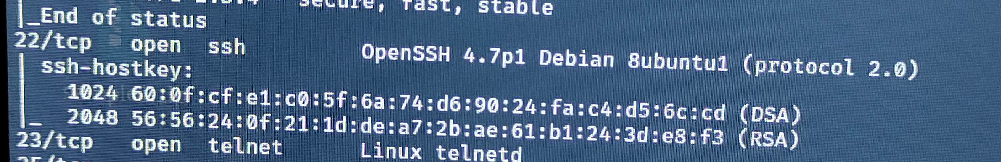
SSH Server Host-key Too Small
Vulnerability Detection Report:
DSA BITS
RSA BITS

Slide 17
RPCBIND
Observation:
We have observed that RPCBIND is running and it is vulnerable. It listened on a high numbered of UDP port , which may not be filtered since the standard port number is 111.
RISK: |  | High |  | Medium |  |  | Low
rpcbind 0.2.0 does not properly validate (1) /tmp/portmap.xdr and (2) /tmp/rpcbind.xdr, which can be created by an attacker before the daemon is started
RECOMMENDATION:
Disable this service if RPC are not used , or update your firewall rules if needed. Update the affected rpcbind or rpcbond-debuginfo package.
 |  |  |  |  | AFFECTED DEVICE:
.

Slide 18
vsftpd 2.3.4
Observation:
The VSFTPD v2.3.4 service was running as root which gave us a root shell on the box. It is very unlikely you will ever encounter this vulnerability in a live situation because this version of VSFTPD is outdated and was only available for one day.
RISK: |  | High |  | Medium |  |  | Low
This vulnerabilities can give access to the attacker to the system and then he can run the privilege escalation so he can get the root access of the system and can steal all the confidential data.
RECOMMENDATION:
vsftpd 2.3.4 downloaded between 20110630 and 20110703 contains a backdoor which opens a shell on port 6200/tcp. Secure transmission that protects the username and password, and encrypts the content, FTP is often secured with SSL/TLS (FTPS) or replaced with SSH File Transfer Protocol (SFTP).
 |  |  |  |  | AFFECTED DEVICE:
.

Slide 19
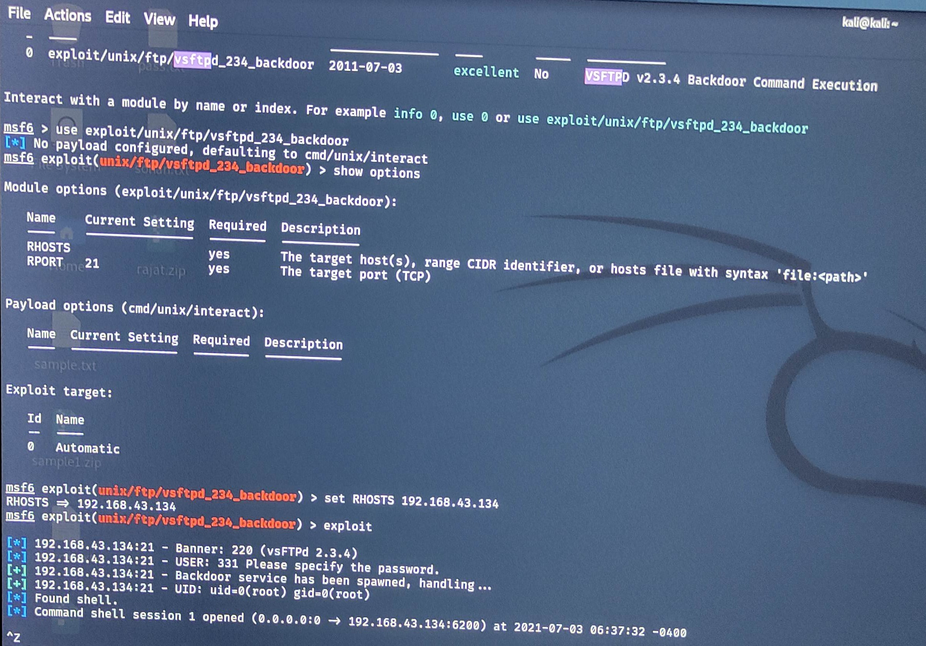
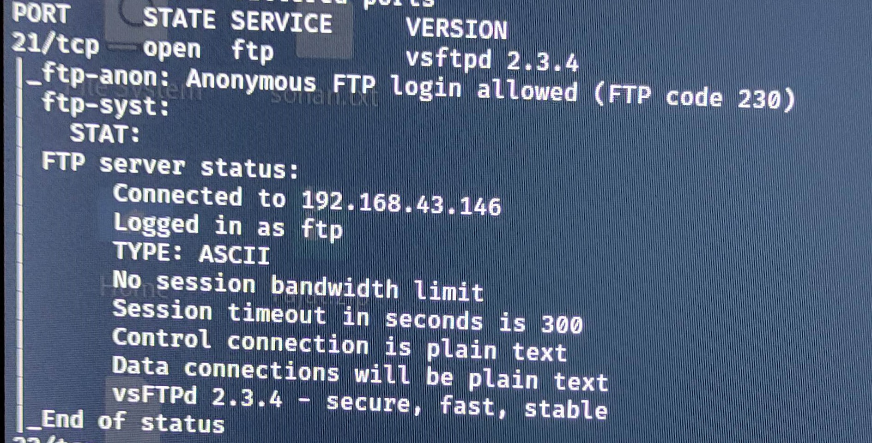
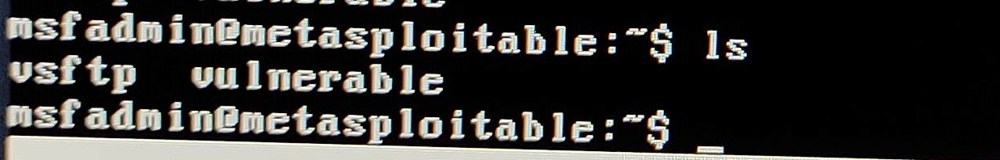
vsftpd 2.3.4
Vulnerability Detection Report:
Exploit the Vulnerability

Slide 20
Apache Tomcat/Coyote JSP engine 1.1
Observation:
We observed that the server are running on the older version of Apache (5.5) . This version is vulnerable to various publicly know vulnerability such as Authentication Bypass 3. Cross Site Scripting Denial of Service 4. Arbitrary command execution
RISK: |  | High |  | Medium |  |  | Low
A remote attacker may exploit these vulnerability to gain access of confidential information or even access to denial of service condition.
RECOMMENDATION:
We recommend to upgrade Apache to latest stable release. We also recommend to review the current security patch arrangement process to ensure continuous monitoring for new security patches and upgrades.
 |  |  |  |  | AFFECTED DEVICE:
.

Slide 21
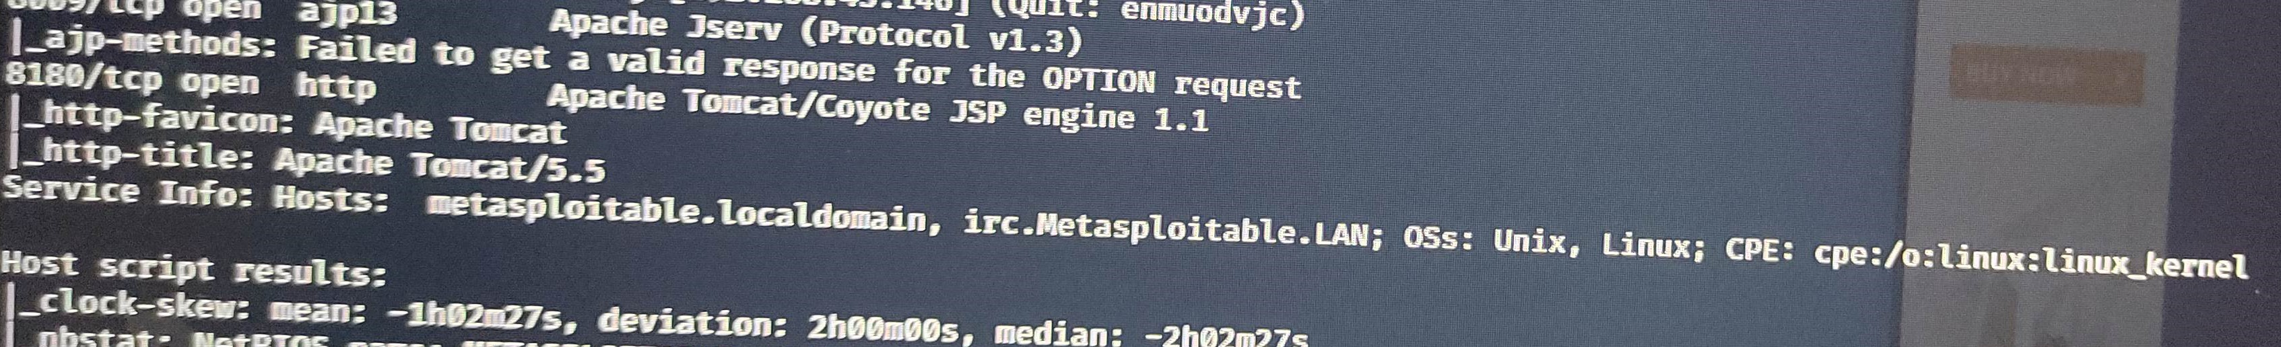
Apache Tomcat/Coyote JSP engine 1.1
Vulnerability Detection Report:

Slide 22
Java-rmi (Remote Method Invocation)
Observation:
We have observe that the Java-rmi is vulnerable for the server. Default configuration of RMI registry allows loading classes from remote URLs which can lead to remote code execution.
RISK: |  | High |  | Medium |  |  | Low
Attacker can gain access from remote URL’s which can lead to remote code execution so the data can be stolen.
RECOMMENDATION:
RMI services permit remote anonymous user to load arbitrary Java classes via the class Loader so remove the access. RMI services handle anonymous request to load and execute Java classes from any remote(HTTP) URL by default. Upgrade the current Java version used by Open Edge to the later supported version update.
 |  |  |  |  | AFFECTED DEVICE:
.

Slide 23
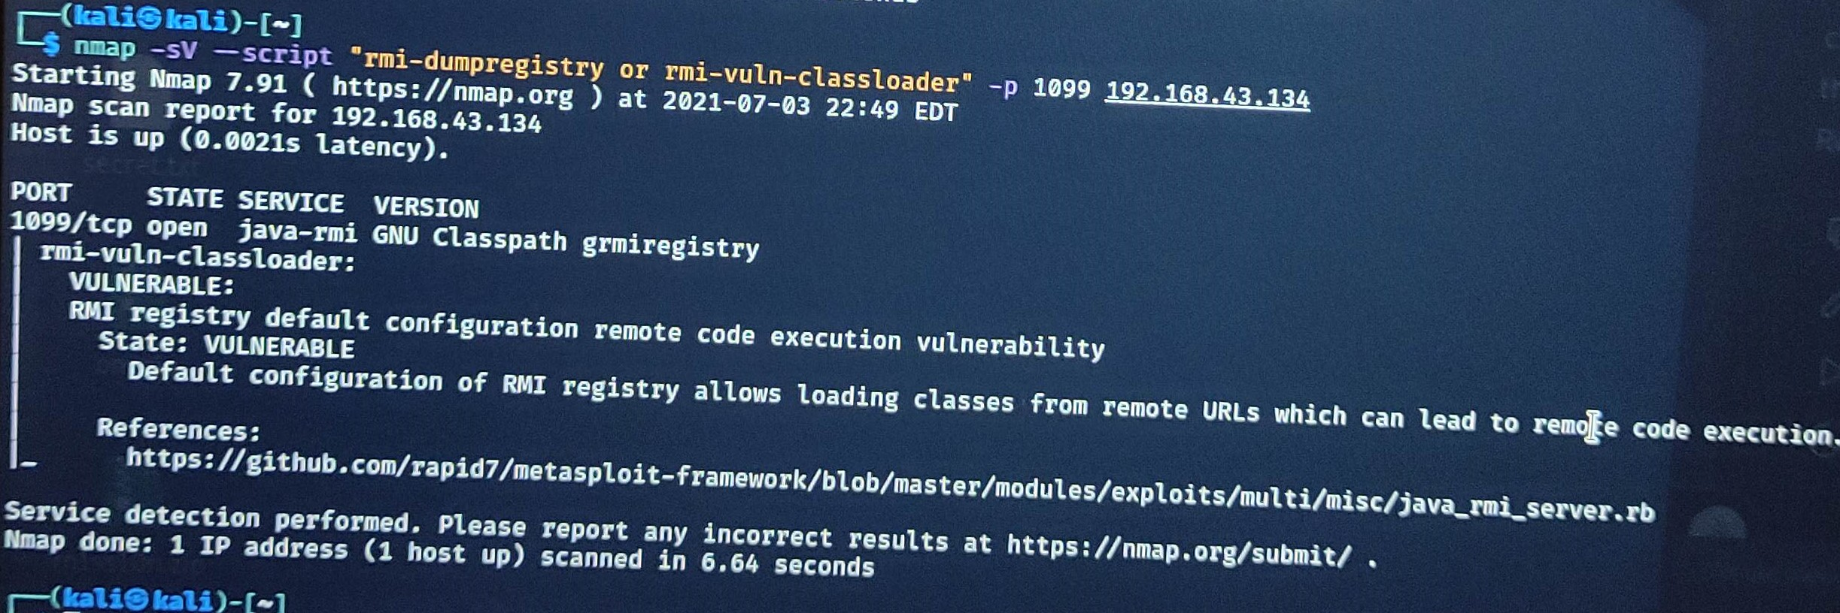
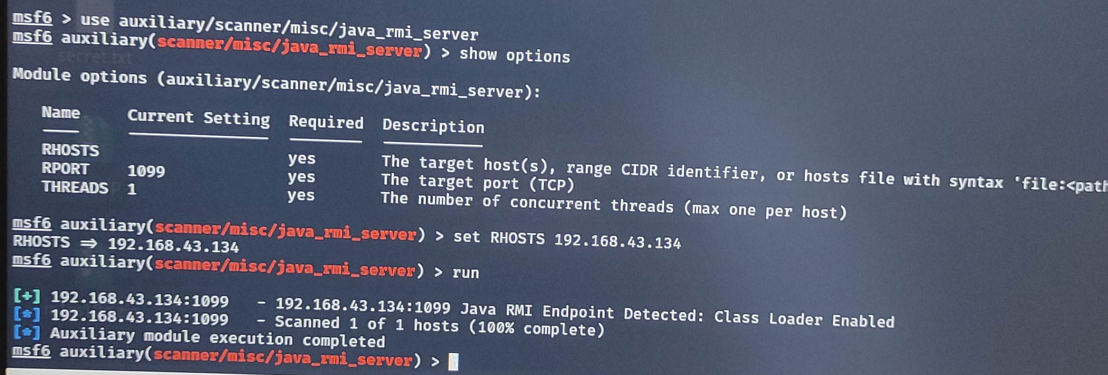
Java-rmi (Remote Method Invocation)
Vulnerability Detection Report:

Slide 24
Apache Jserv Protocol (V1.3)
OBSERVATION:
This vulnerability is vulnerable to various publicly known vulnerability like: Authentication Bypass Denial of Service Cross slide scripting
RISK: |  | High |  | Medium |  |  | Low
With this vulnerability, attacker can easily gain access to configuration files if the protocol is publicly available. If arbitrary files upload is not disable.it is then possible for attacker to upload the malicious code to web server.
RECOMMENDATION:
When using ATP care must be taken when trusting incoming connection to Apache Tomcat.
 |  |  |  |  | AFFECTED DEVICE:
.

Slide 25
Pentesting PostgreSQL
Observation:
We have that the system is using the old version of PostgreSQL , so which made lead to the occurring of vulnerability.
RISK: |  | High |  | Medium |  |  | Low
An attacker can create privilege on some non-temporary scgema or trigger privilege on some table to create a malicious trigger.
RECOMMENDATION:
Install update provided by PostgreSQL. Verify no authorised modification have occurred on system before applying batch. Monitor introsion . detection system for any sign of anomalous activity Unless required limit external network access to affected product.
 |  |  |  |  | AFFECTED DEVICE:
.

Slide 26
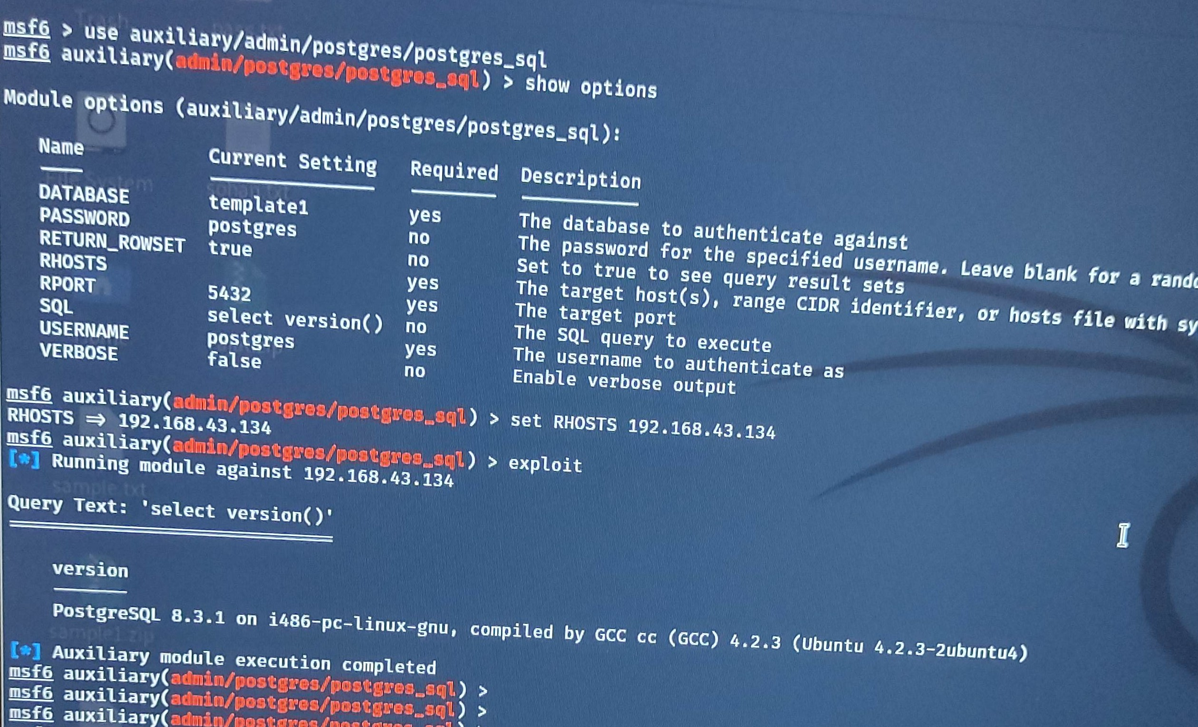
Pentesting PostgreSQL
Vulnerability Detection Report:
OLDER VERSION

Slide 27
DNS-RECURSION
Observation:
We have observed that the DNS-RECURSION is enabled . It is possible to query name server for third-party names.
RISK: |  | High |  | Medium |  |  | Low
DNS recursive resolvers vulnerability can launch DDoS attacks against any victim.
RECOMMENDATION:
Unless this server is an internal server, or intentionally serves name queries(or name server(such as those LAN connected to it)), the recursive queries option should be disable.
 |  |  |  |  | AFFECTED DEVICE:
.

Slide 28
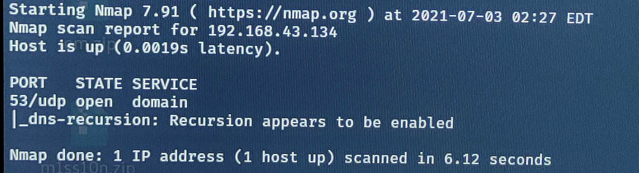
DNS-RECURSION
Vulnerability Detection Report:

Slide 29
Oracle MySQL(older version)
Observation:
We have observed that the system is running on the older version of Oracle MySQL. Supported versions that are affected are 5.7.33 and prior and 8.0.23 and prior. Easily exploitable vulnerability allows unauthenticated attacker with logon to the infrastructure where MySQL Server executes to compromise MySQL Server.
RISK: |  | High |  | Medium |  |  | Low
Successful attacks of this vulnerability can result in unauthorized access to critical data or complete access to all MySQL. Server accessible data as well as unauthorized update, insert or delete access to some of MySQL Server accessible data.
RECOMMENDATION:
Upgrade to the latest version of Oracle MySQL to fix the vulnerability.
 |  |  |  |  | AFFECTED DEVICE:
.

Slide 30
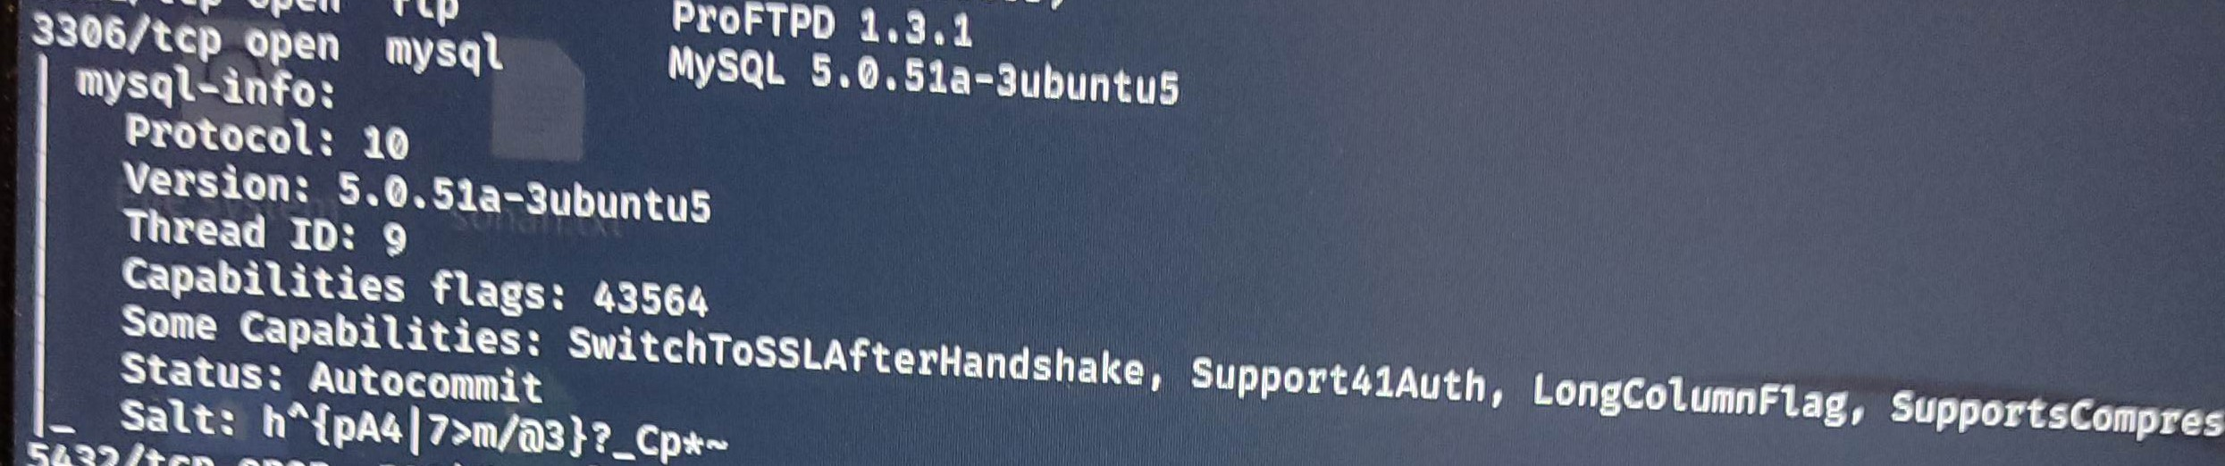
Oracle MySQL(older version)
Vulnerability Detection Report:
OLDER VERSION

Slide 31
Smb(Server Message Block)-os-Discovery
Observation:
This vulnerability is attempt by using the anonymous account or with proper user account. The following output can be seen as the result when vulnerability is executed successfully. Computer name Domain Name OS System time and many more etc.
RISK: |  | High |  | Medium |  |  | Low
The attacker can gain the information like Computer name, Domain Name, Operating System, Forest Name ,FQNP , Workshop , System time, NETBIOS computer name and NETBIOS domain name etc. Attackers to leak kernel memory remotely, and when combined with a previously disclosed "wormable" bug, the flaw can be exploited to achieve remote code execution attacks.
RECOMMENDATION:
Restrict access to those shared by a password, and filter the NetBIOS port from outside access.
 |  |  |  |  | AFFECTED DEVICE:
.

Slide 32
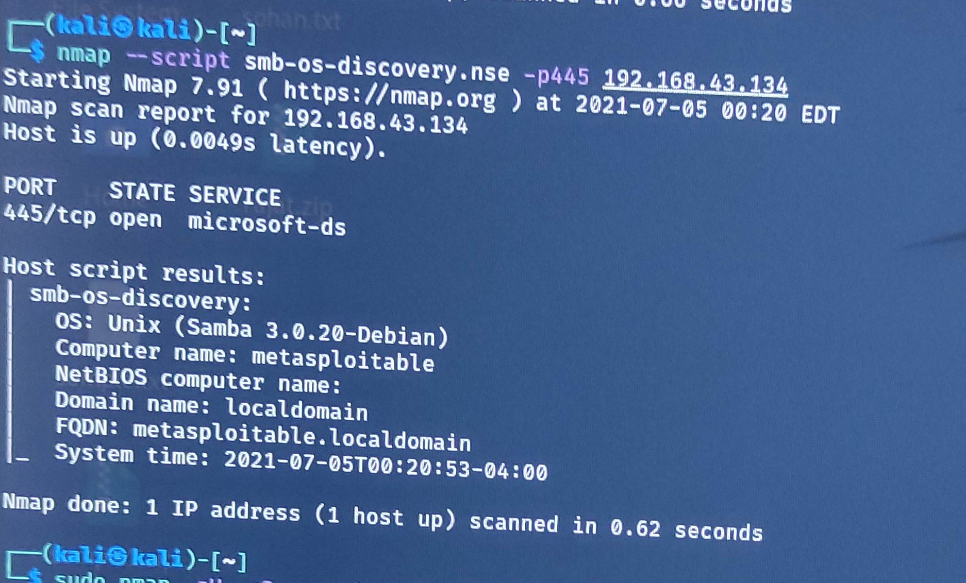
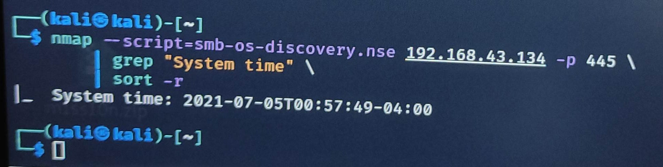
Smb(Server Message Block)-os-Discovery
Vulnerability Detection Report:
System time can be check.
This is too vulnerability for 445/tcp port for checking system time

Slide 33
Smb(Server Message Block)-security-mode
Observation:
This vulnerability is attempt by using the anonymous account or with proper user account. The following output can be seen as the result when vulnerability is executed successfully. Computer name Domain Name OS System time and many more etc.
RISK: |  | High |  | Medium |  |  | Low
The attacker can gain the information like Computer name, Domain Name, Operating System, Forest Name ,FQNP , Workshop , System time, NETBIOS computer name and NETBIOS domain name etc. Attackers to leak kernel memory remotely, and when combined with a previously disclosed "wormable" bug, the flaw can be exploited to achieve remote code execution attacks.
RECOMMENDATION:
Enforce message signing in the host’s configuration. On Samba , the setting is called ‘server signing’.
 |  |  |  |  | AFFECTED DEVICE:
.

Slide 34
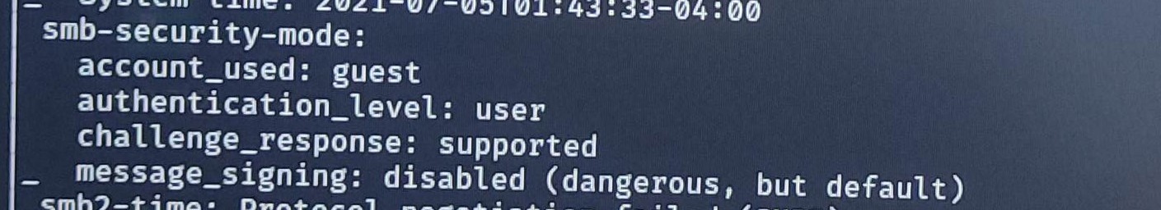
smb-security-mode
Vulnerability Detection Report:

Slide 35
TCP/IP Timestamps Supported
Observation:
We observe that time on the server is not set as per Indian Time Zone. A side effect of this feature is that the uptime of the remote host can sometimes be computed.
RISK: |  | High |  | Medium |  |  | Low
Any cron job or schedule task is based on time can be executed on wrong time.
RECOMMENDATION:
Configure secure NTP channels to update time on server.
 |  |  |  |  | AFFECTED DEVICE:
.

Slide 36
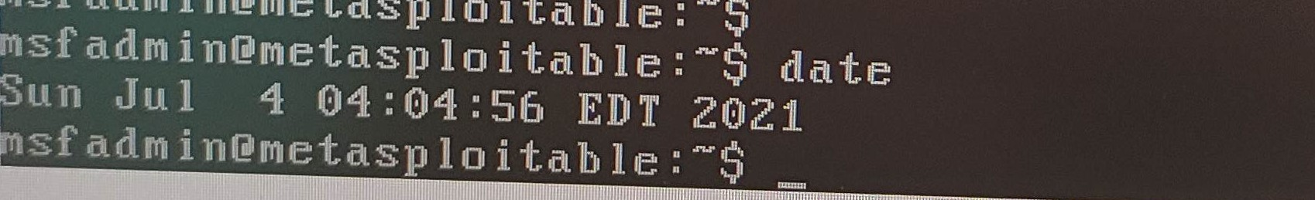
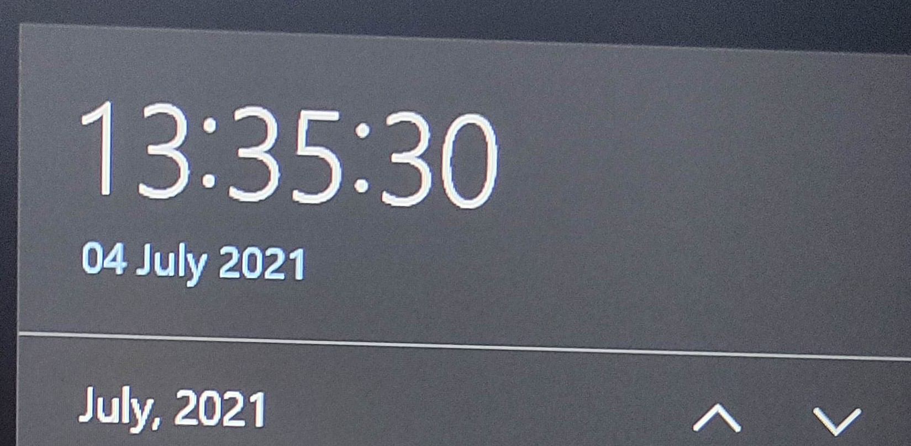
TCP/IP Timestamps Supported
Vulnerability Detection Report:
Both the screenshot was taken at same time at 01:35PM (GMT+5:30)

Slide 37
Traceroute Information
Observation:
This vulnerability makes a traceroute to the remote host. It is the npm package used for listing references in a remote git repository.
RISK: |  | High |  | Medium |  |  | Low
An adversary uses a traceroute utility to map out the route which data flows through the network in route to a target destination.
RECOMMENDATION:
Tracert is a Windows based command-line tool that you can use to trace the path that an Internet Protocol (IP) packet takes to its destination from a source, so we can check on Command Prompt(CMD).
 |  |  |  |  | AFFECTED DEVICE:
.

Slide 38
Vulnerability Assessment on website testphp.vulnweb.com

Slide 39
Vulnerability Statistic
Type of Risk | Number of Vulnerability
HIGH | 5
MEDIUM | 8
LOW | 1

Slide 40
SQL INJECTION
Observation:
We observe that the website is exploited by the CGI script , hashes on the remote webserver and got different responses which implies that the attacker can modify the responses and directly can access to the database.
RISK: |  | High |  | Medium |  |  | Low
This vulnerability can leave to the application at a HIGH-RISK of comprise resulting in an impact to the confidentiality and integrity of data as well as authentication and authorisation aspect to the application.
RECOMMENDATION:
We recommend to modify the CGI script so they can properly accept the response. While maintaining full application functionality is to use parameterized queries(Prepared Statement).
 |  |  |  |  | AFFECTED DEVICE:
.

Slide 41
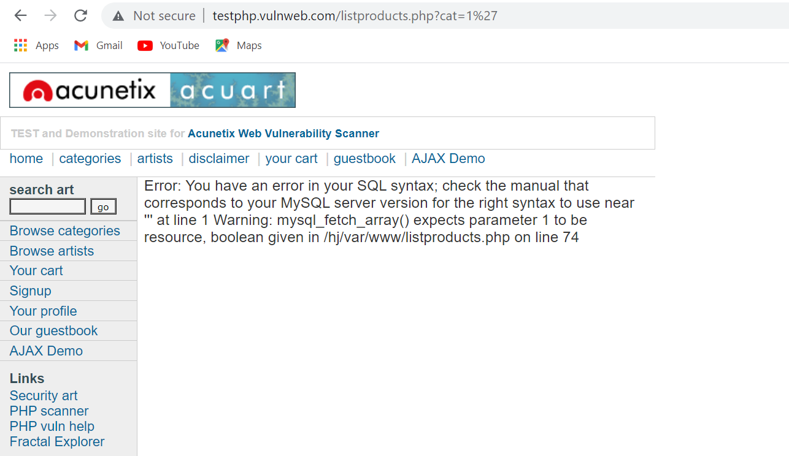
SQL INJECTION
Vulnerability Detection Report:
http://testphp.vulnweb.com/listproduct.php?cat=1’

Slide 42
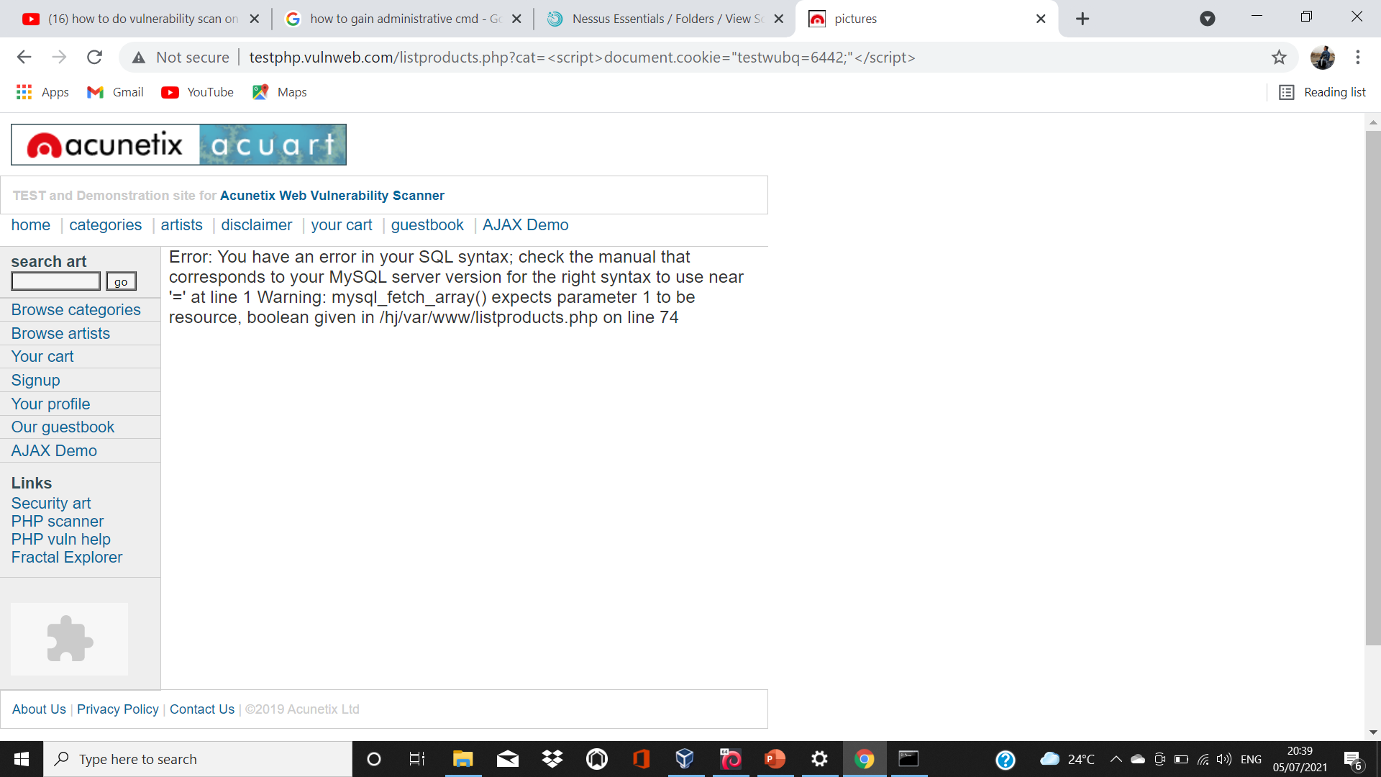
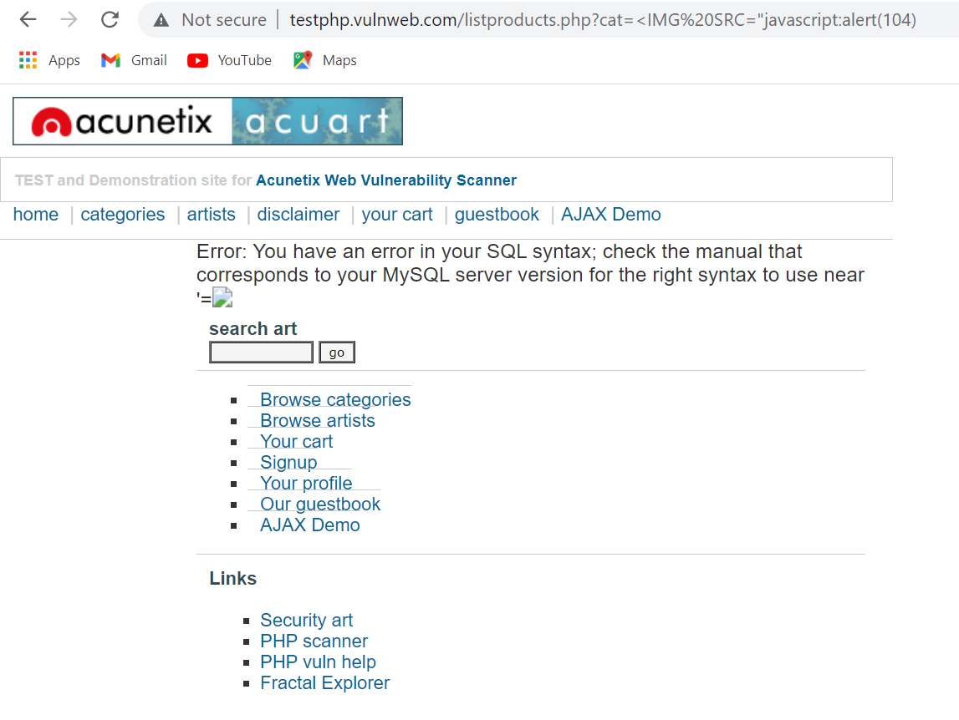
Vulnerability Detection Report:
http://testphp.vulnweb.com/listproducts.php?cat=%3Cscript%3Edocument.cookie=%22testwubq=6442;%22%3C/script%3E
http://testphp.vulnweb.com/listproducts.php?cat=%3CIMG%20SRC=%22javascript:alert(104)

Slide 43
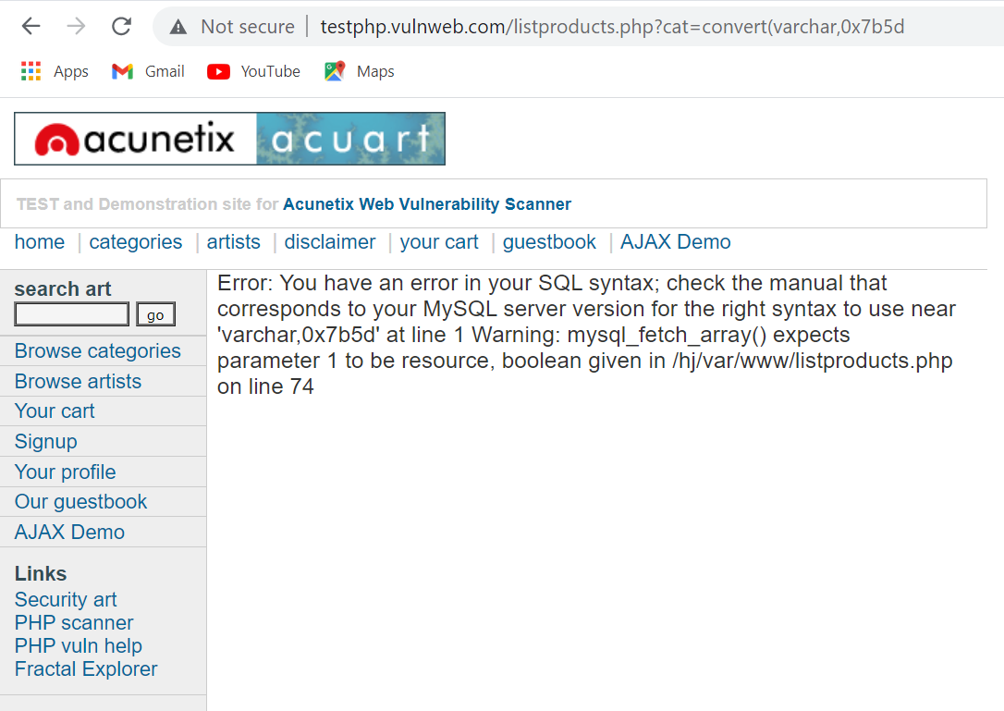
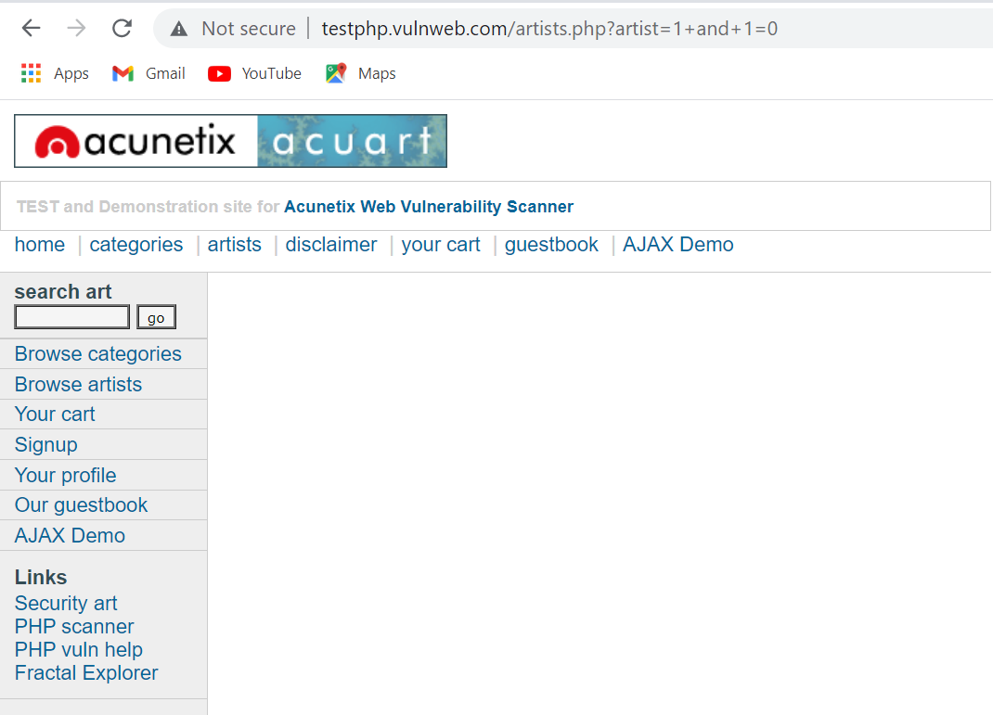
Vulnerability Detection Report:
http://testphp.vulnweb.com/listproducts.php?cat=convert(varchar,0x7b5d
http://testphp.vulnweb.com/artists.php?artist=1+and+1=0

Slide 44
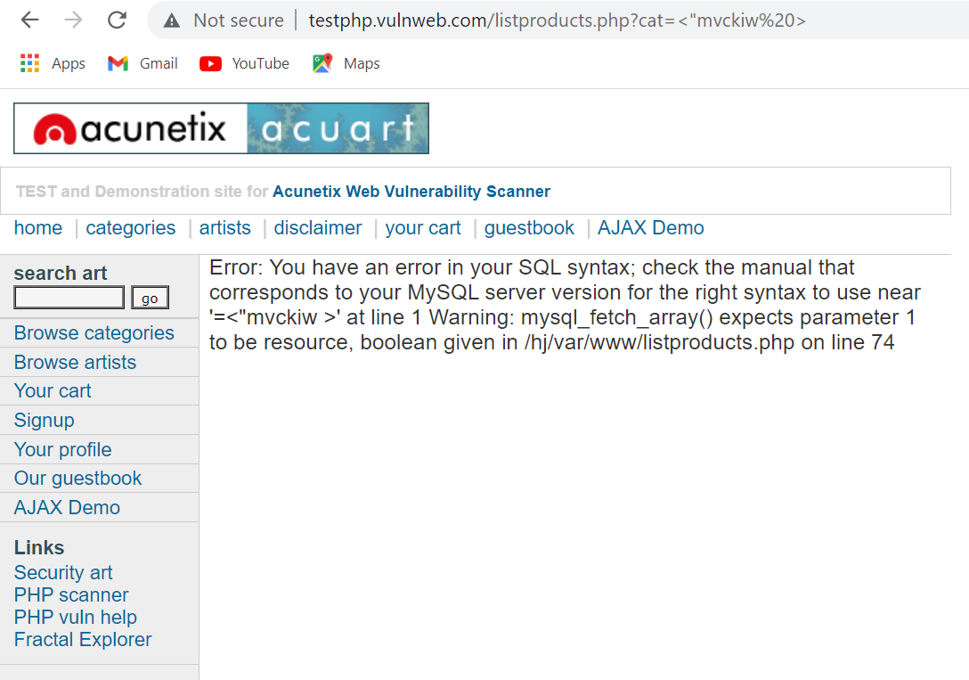
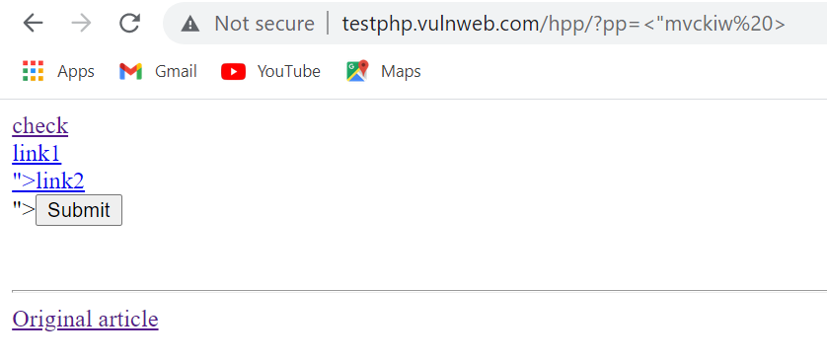
Vulnerability Detection Report:
http://testphp.vulnweb.com/hpp/?pp=%3C%22mvckiw%20%3E
http://testphp.vulnweb.com/hpp/?pp=%3C%22mvckiw%20%3E

Slide 45
Cross-Site Scripting(XSS)
Observation:
The remote web server hosts CGI scripts that fail to adequately sanitize request strings with malicious JavaScript. The application is taking untrusted data(i.e. from the client) and reusing it without performing any validation or sanitisation.
RISK: |  | High |  | Medium |  |  | Low
An attacker can take control over the credential database by just typing a correct JavaScript. An attacker can impersonate a legitimate user and take over their account. In short the attacker can Hijacked our account, credential can be stolen, sensitive data could be exfiltrated and lastly access to client computer can be obtained.
RECOMMENDATION:
We can prevent XSS attack by following prevention: Filter input on arrival Encode data on output Content security policy Use appropriate response header
 |  |  |  |  | AFFECTED DEVICE:
.

Slide 46
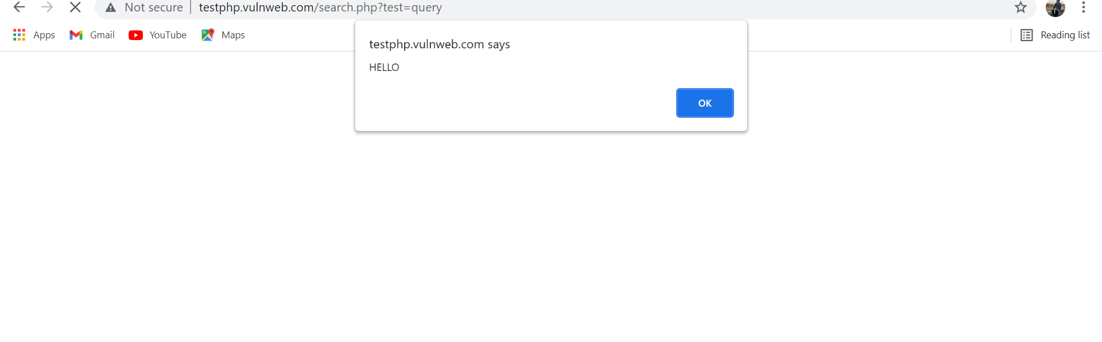
Cross-Site Scripting(XSS)
Vulnerability Detection Report:
Type this javascript in search box:
<script>alert(‘HELLO’)</script>

Slide 47
PHP Unsupported Version Detection
Observation:
According to its version, the installation of PHP on the remote host is no longer supported. Lack of support implies that no new security patches for the product will be released by the vendor. As a result, it is likely to contain security vulnerabilities.
RISK: |  | High |  | Medium |  |  | Low
The attacker can connect to the NSCilent and retrieve sensitive information ,such as process and service states , memory usage and many more.
RECOMMENDATION:
Upgrade to a version of PHP that is currently supported. Update to the latest version to fix the vulnerabilities.
 |  |  |  |  | AFFECTED DEVICE:
.

Slide 48
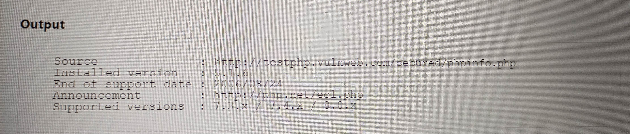
PHP Unsupported Version Detection
Vulnerability Detection Report:
Upgrade Version
Current Version

Slide 49
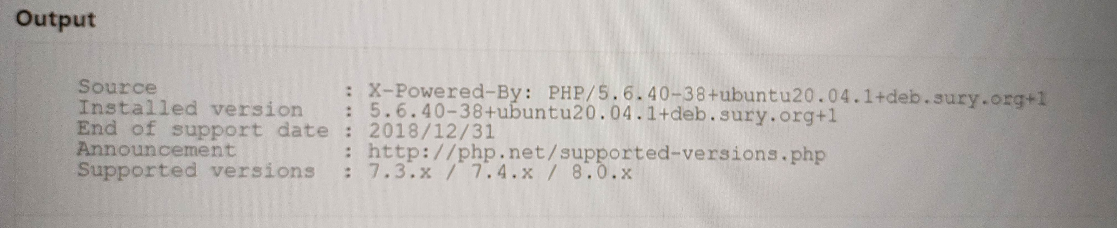
PHP Unsupported Version Detection
Vulnerability Detection Report:
Supported Version
Current Version

Slide 50
SQLi Scanner
Observation:
The scanner was able to send specially crafted input to one or more endpoints and parameters on the remote host that resulted in an injection into a SQL query, allowing arbitrary SQL statements to be executed on the remote host.
RISK: |  | High |  | Medium |  |  | Low
The attacker may result in the unauthorized viewing of user list , the deletion of entire table and in certain cases the attacker may gain the administrative tight to the database.
RECOMMENDATION:
In the case of a third party product, the vendor should be notified of this vulnerability. In the case of a custom web application, the application should be updated to use parameterized queries, which prevent an attacker from being able to inject special characters that can be used to break out of the intended context and execute SQL statements.
 |  |  |  |  | AFFECTED DEVICE:
.

Slide 51
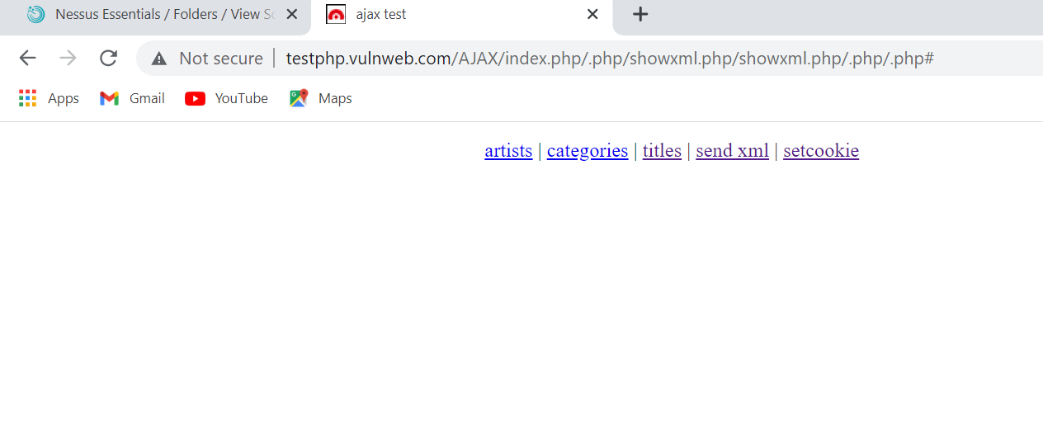
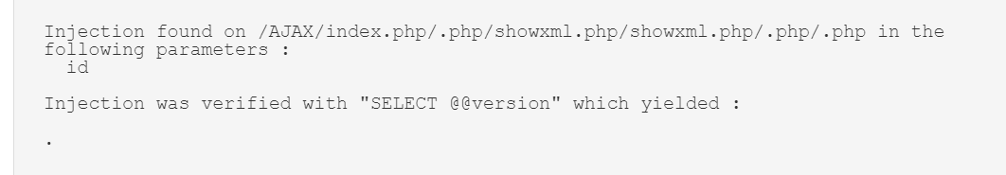
SQLi Scanner
Vulnerability Detection Report:

Slide 52
CGI Query String Code Execution
Observation:
According to its banner, the version of PHP installed on the remote host is earlier than 5.3.12 / 5.4.2, and as such is potentially affected by a remote code execution and information disclosure vulnerability.
RISK: |  | High |  | Medium |  |  | Low
PHP could allow a remote attacker to execute arbitrary code on the system,due to an incomplete fix for an error related to parsing PHP CGI configuration. An attacker could exploit this vulnerability to execute arbitrary code on the system.
RECOMMENDATION:
Upgrade to PHP version 5.3.12 / 5.4.2 or later. A 'mod rewrite' workaround is available as well.
 |  |  |  |  | AFFECTED DEVICE:
.

Slide 53
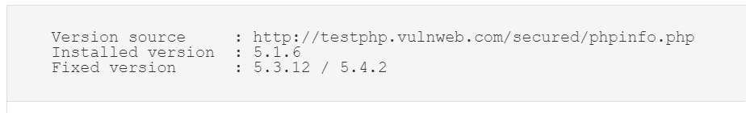
CGI Query String Code Execution
Vulnerability Detection Report:
Fixed Version
Installed Version

Slide 54
HTML INJECTION
Observation:
The remote web server hosts CGI scripts that fail to adequately sanitize request strings with malicious JavaScript. By leveraging this issue, an attacker may be able to cause arbitrary HTML to be executed in a user's browser within the security context of the affected site.
RISK: |  | High |  | Medium |  |  | Low
It allow the attacker to modify the page. To steal another personal identity. The attacker might send the malicious HTML page to victim.
RECOMMENDATION:
Either restrict access to the vulnerable application or contact the vendor for an update.
 |  |  |  |  | AFFECTED DEVICE:
.

Slide 55
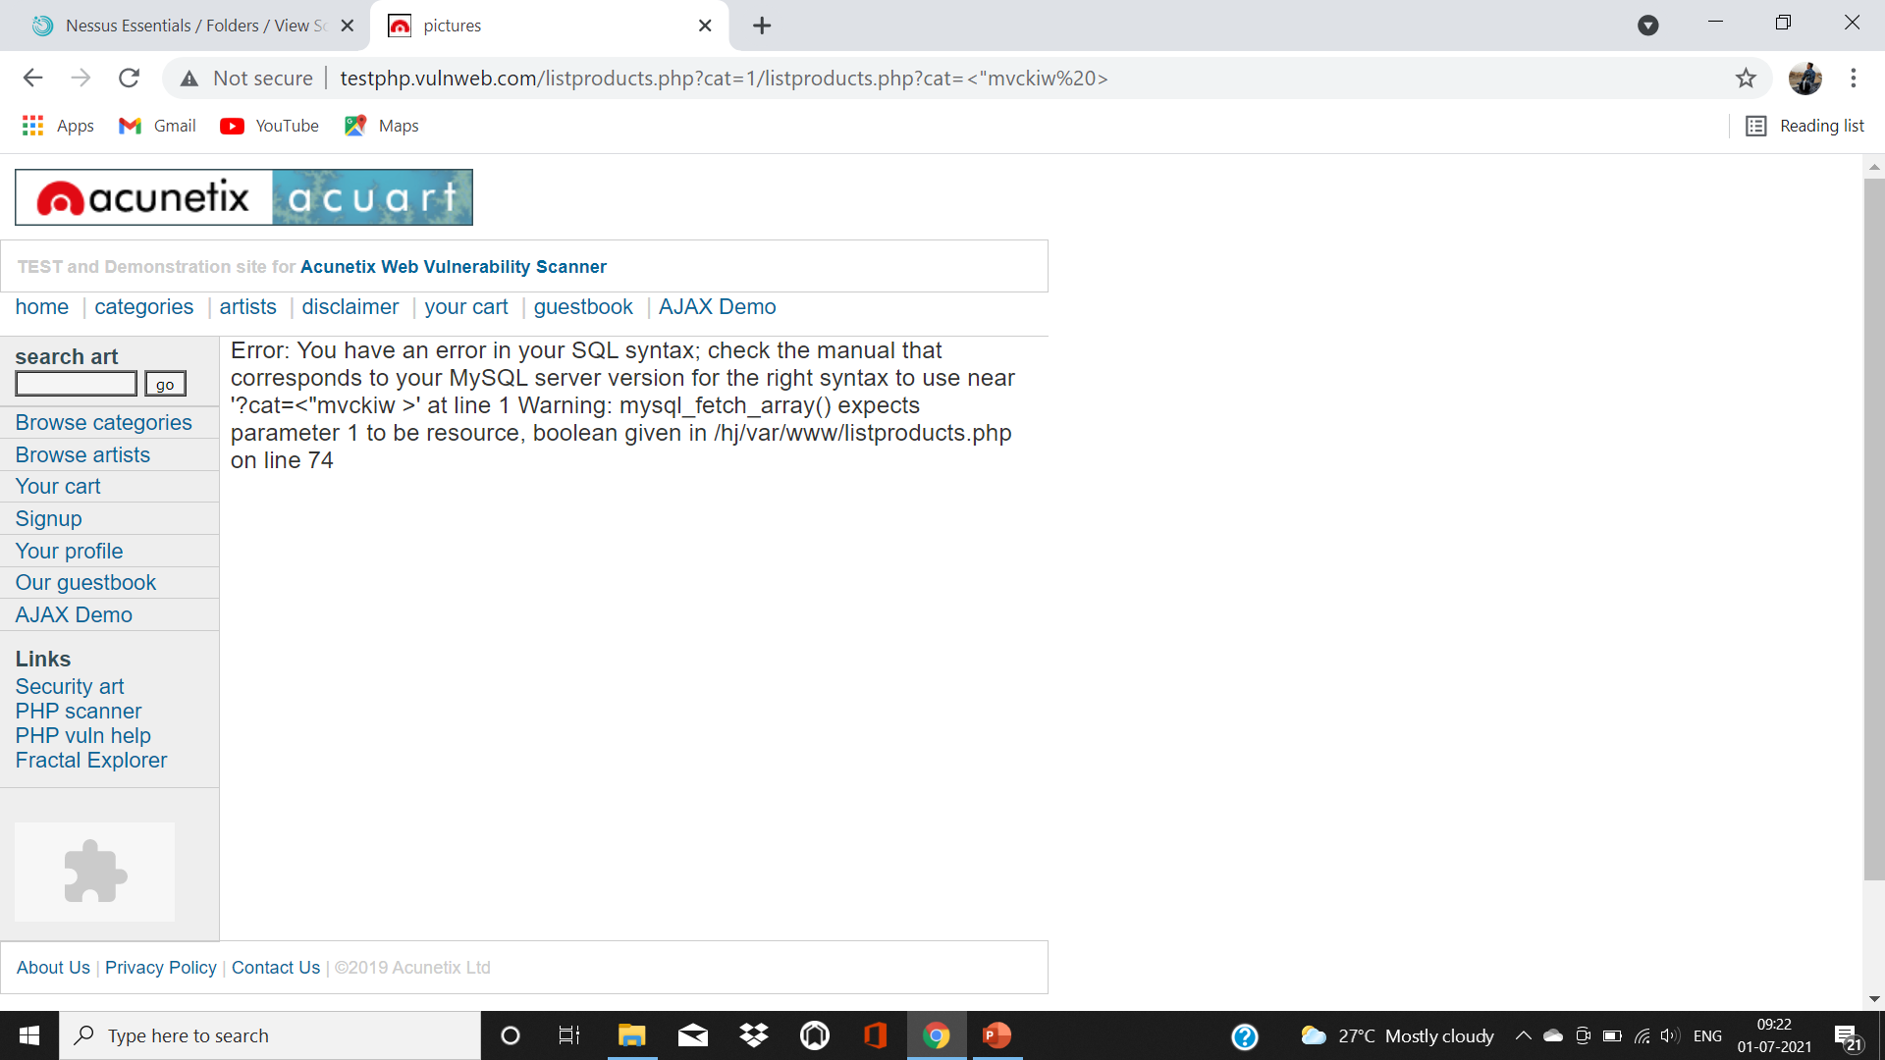
HTML INJECTION
Vulnerability Detection Report:
Vulnerability
http://testphp.vulnweb.com/listproducts.php?cat=<"mvckiw%20>

Slide 56
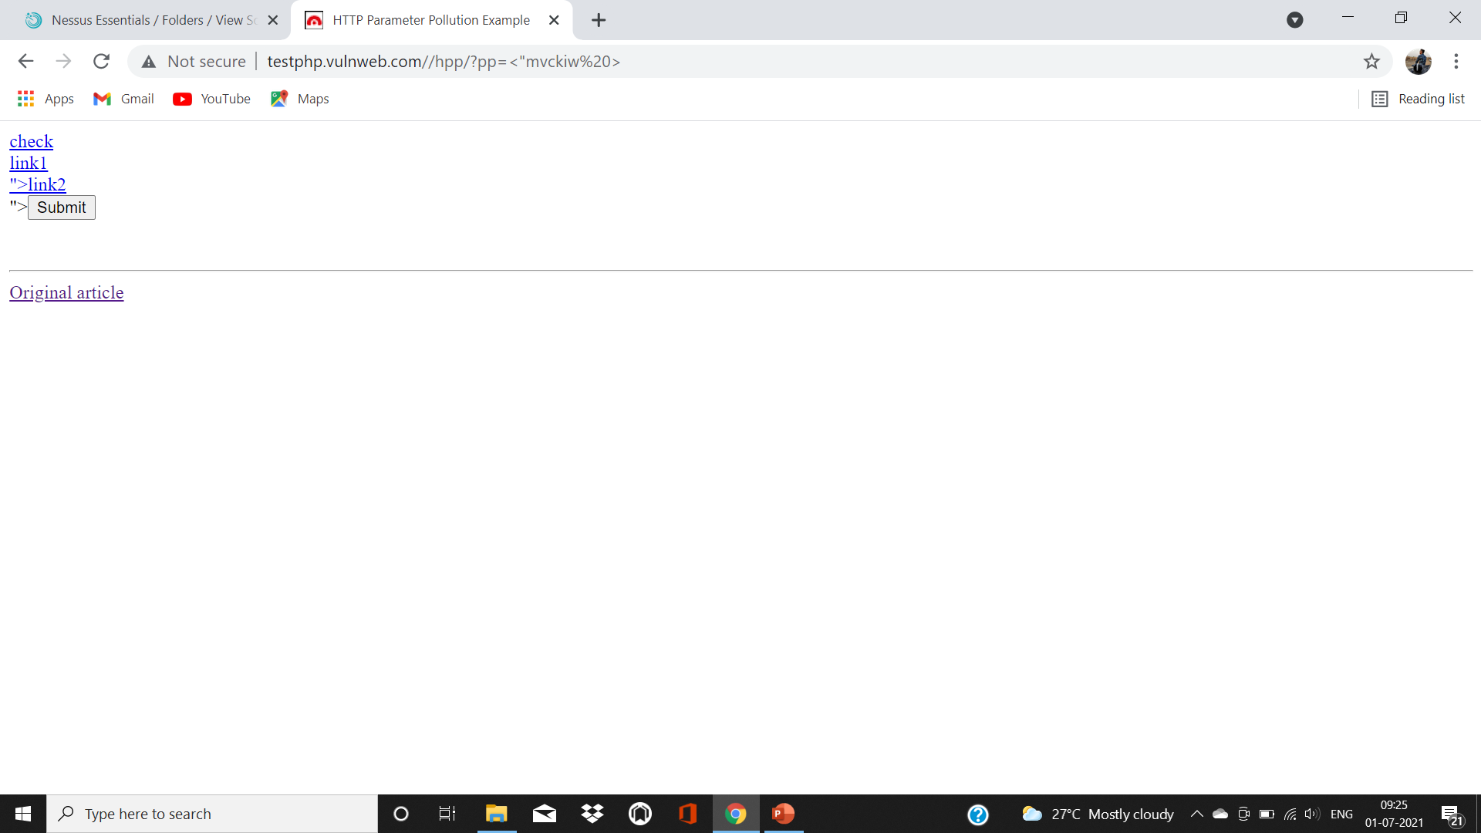
HTML INJECTION
Vulnerability Detection Report:
Vulnerable Link
http://testphpvulnweb.com/hpp/?pp<“mvckiw%20>

Slide 57
Web Application SQL Backend Identification
Observation:
At least one web application hosted on the remote web server is built on a SQL backend that Nessus was able to identify by looking at error messages
RISK: |  | High |  | Medium |  |  | Low
Leaking this kind of information may help the attacker fine-tune attacks against the application and its backend.
RECOMMENDATION:
Filter out error messages.
 |  |  |  |  | AFFECTED DEVICE:
.

Slide 58
Web Application Potentially Vulnerable to Clickjacking
Observation:
We have observed that the remote web server does not set an X-Frame-Options response header or a Content-Security-Policy 'frame-ancestors' response header in all content responses. This could potentially expose the site to a clickjacking or UI redress attack.
RISK: |  | High |  | Medium |  |  | Low
An Attacker can trick a user into clicking an area of the vulnerable page that is different than what the user perceives the page to be. This can result in a user performing fraudulent or malicious transactions.
RECOMMENDATION:
Return the X-Frame-Options or Content-Security-Policy (with the 'frame-ancestors' directive) HTTP header with the page's response. This prevents the page's content from being rendered by another site when using the frame or iframe HTML tags.
 |  |  |  |  | AFFECTED DEVICE:
.

Slide 59
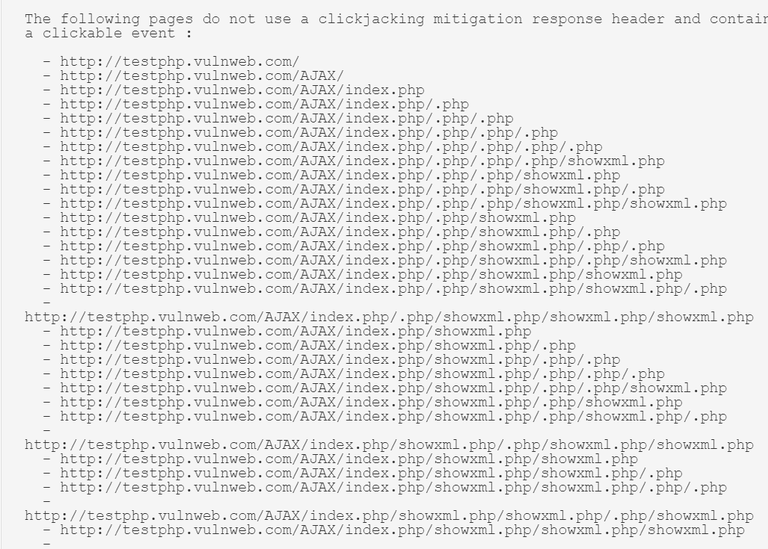
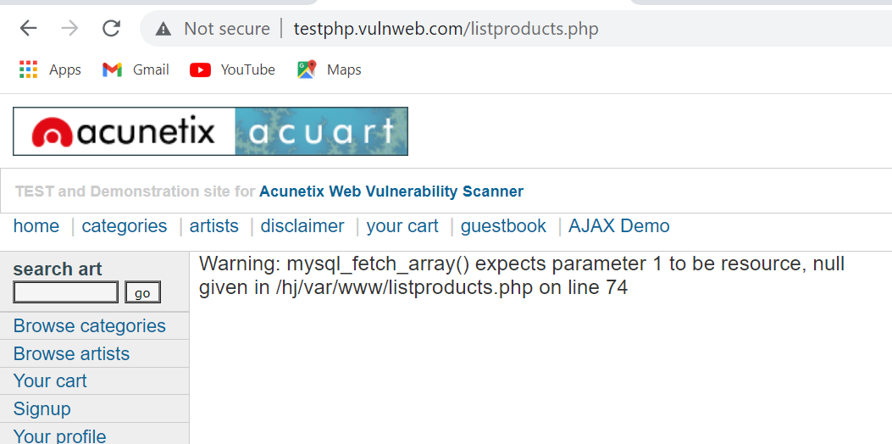
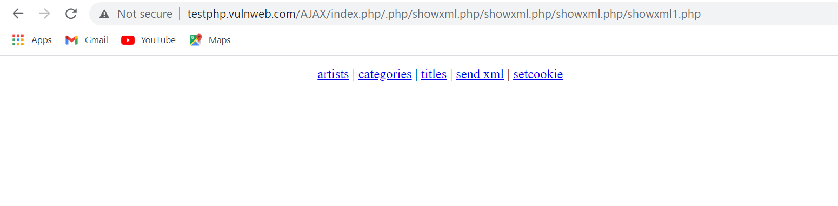
Web Application Potentially Vulnerable to Clickjacking
Vulnerability Detection Report:
http://testphp.vulnweb.com/listproduct.php
http://testphp.vulnweb.com/AJAX/index.php//php/showxml.php/showxml.php/showxml.php/showxmp1.php

Slide 60
PHP_RSHUTDOWN_FUNCTION Security Bypass
Observation:
According to its banner, the version of PHP 5.x installed on the remote host is 5.x prior to 5.3.11 or 5.4.x prior to 5.4.1 and thus, is potentially affected by a security bypass vulnerability.
RISK: |  | High |  | Medium |  |  | Low
Successful Exploitation will allow remote attacker to read arbitrary files.
RECOMMENDATION:
Upgrade to PHP version 5.3.11 / 5.4.1.
 |  |  |  |  | AFFECTED DEVICE:
.

Slide 61
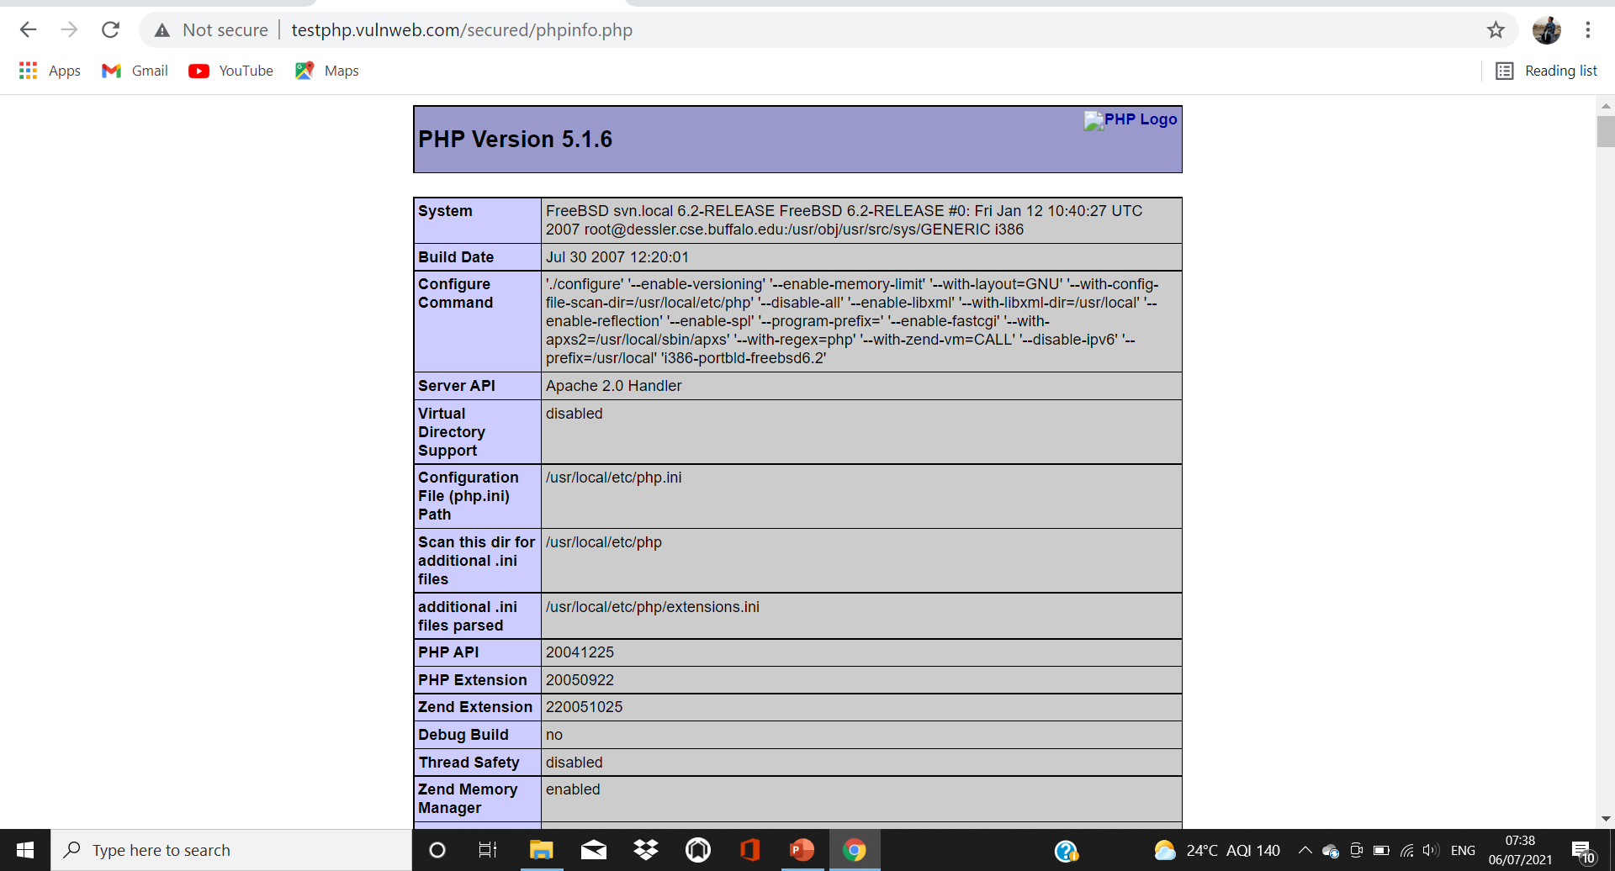
PHP_RSHUTDOWN_FUNCTION Security Bypass
Vulnerability Detection Report:

Slide 62
Generic Cookie Injection Scripting
Observation:
The remote web server hosts at least one CGI script that fails to adequately sanitize request strings with malicious JavaScript.
RISK: |  | High |  | Medium |  |  | Low
By leveraging this issue, an attacker may be able to inject arbitrary cookies. Depending on the structure of the web application, it may be possible to launch a 'session fixation' attack using this mechanism.
RECOMMENDATION:
Restrict access to the vulnerable application. Contact the vendor for a patch or upgrade.
 |  |  |  |  | AFFECTED DEVICE:
.

Slide 63
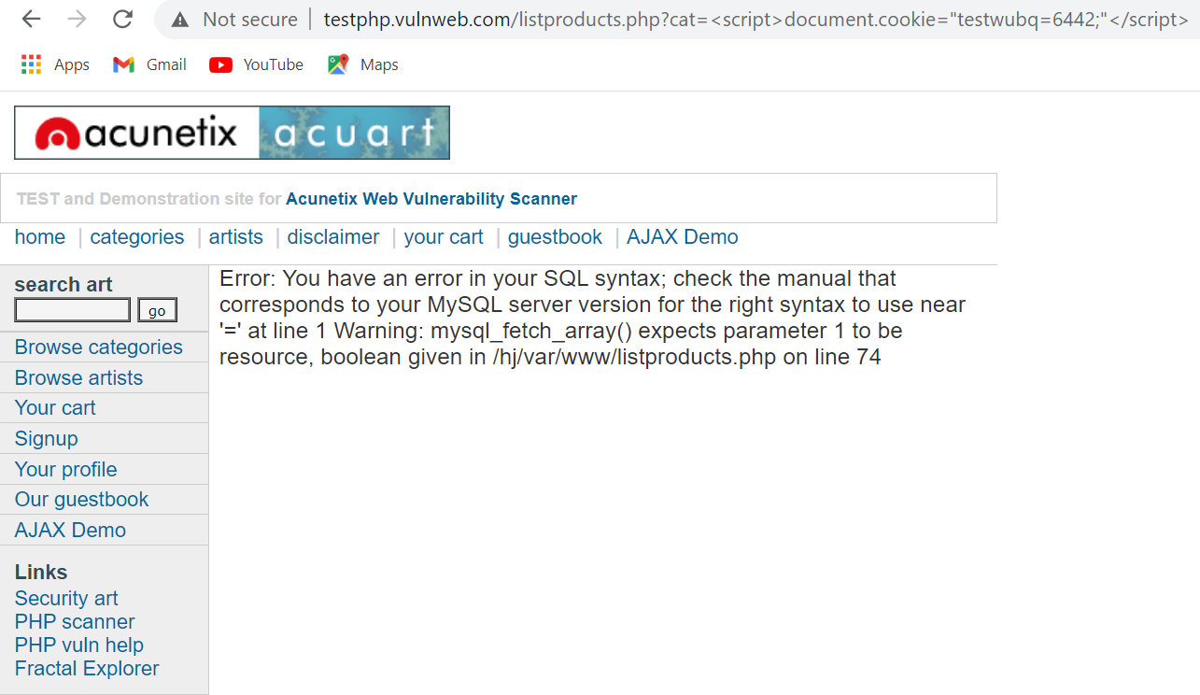
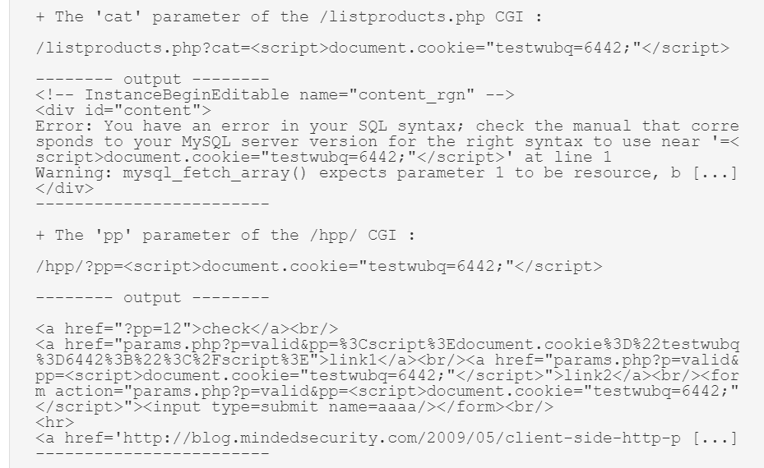
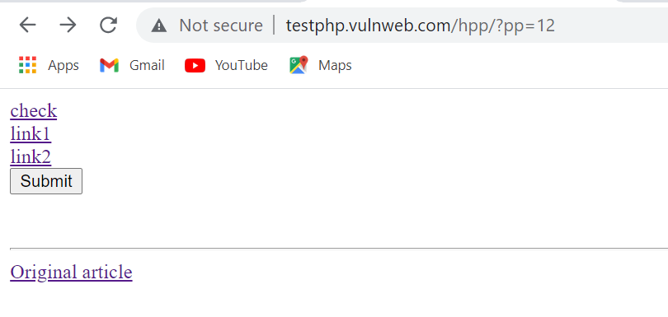
Generic Cookie Injection Scripting
Vulnerability Detection Report:
Vulnerability
http://testphp.vulnweb.com/listproduct.php?cat=<script>document.cookie=“testwubq=6642;”</script>
http://testphp.vulnweb.com.hpp/?pp=12

Slide 64
Web Server info.php / phpinfo.php Detection
Observation:
We have observe that the PHP install on the remote server is configured in a way that allow disclosure of potentially sensitive information.
RISK: |  | High |  | Medium |  |  | Low
Allow disclosure of potentially sensitive information to an attacker through special URL.
RECOMMENDATION:
Remove the affected file(s). In PHP configuration file,php.ini, set the value for ‘exposure_php’ to “OFF” to disable this behavior.
 |  |  |  |  | AFFECTED DEVICE:
.

Slide 65
Generic XSS (quick test)
Observation:
The remote web server hosts CGI scripts that fail to adequately sanitize request strings with malicious JavaScript.
RISK: |  | High |  | Medium |  |  | Low
By leveraging this issue, an attacker may be able to cause arbitrary HTML and script code to be executed in a user's browser within the security context of the affected site.
RECOMMENDATION:
Restrict access to the vulnerable application. Contact the vendor for a patch or upgrade to address any cross-site scripting vulnerabilities.
 |  |  |  |  | AFFECTED DEVICE:
.

Slide 66
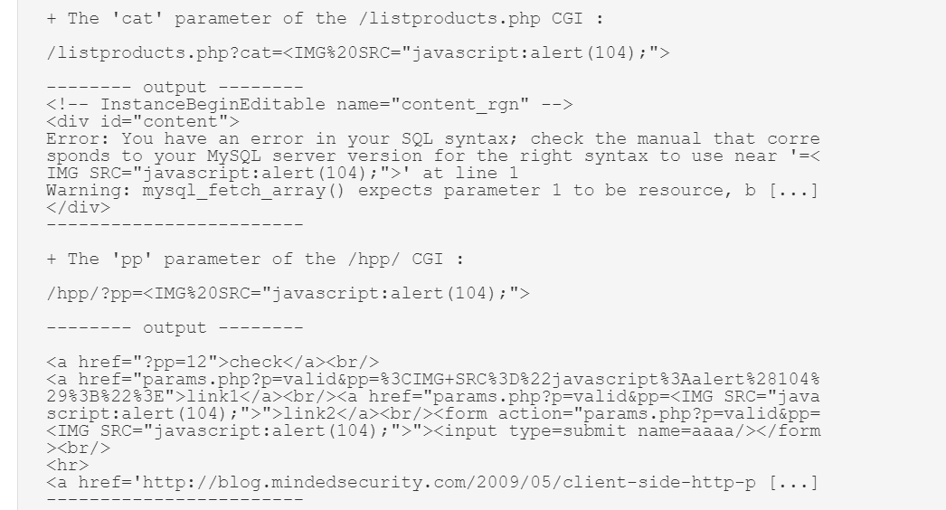
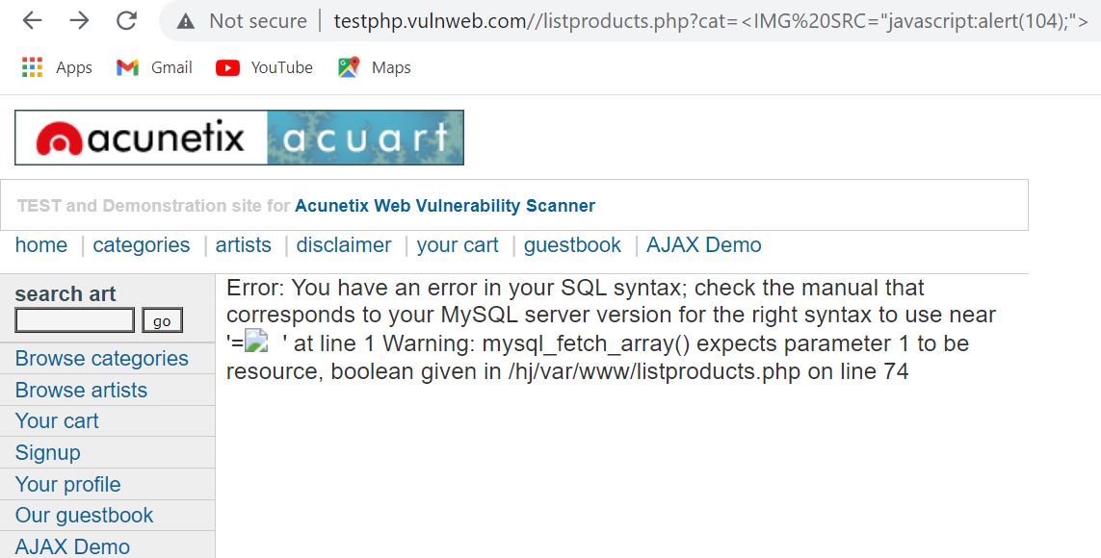
Generic XSS (quick test)
Vulnerability Detection Report:
http://testphp.vulnweb.com/listproduct.php?cat=<IMG%20SRC=“javascript:alert(104);>

Slide 67
Browsable Web Directories
Observation:
We have observed that while accessing a website using web browser and instead of a webpage, we are able to see a list of files and folders.
RISK: |  | High |  | Medium |  |  | Low
As we kept the credential data on browsable directories that it can be get access by attacker.
RECOMMENDATION:
Make sure that browsable directories do not leak confidential information or give access to sensitive resources. Additionally, use access restrictions or disable directory indexing for any that do.
 |  |  |  |  | AFFECTED DEVICE:
.

Slide 68
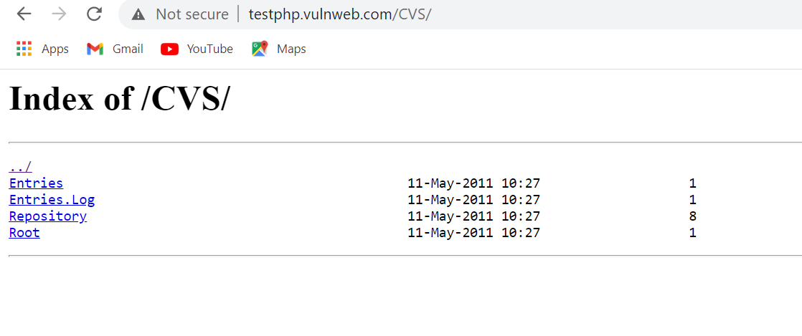
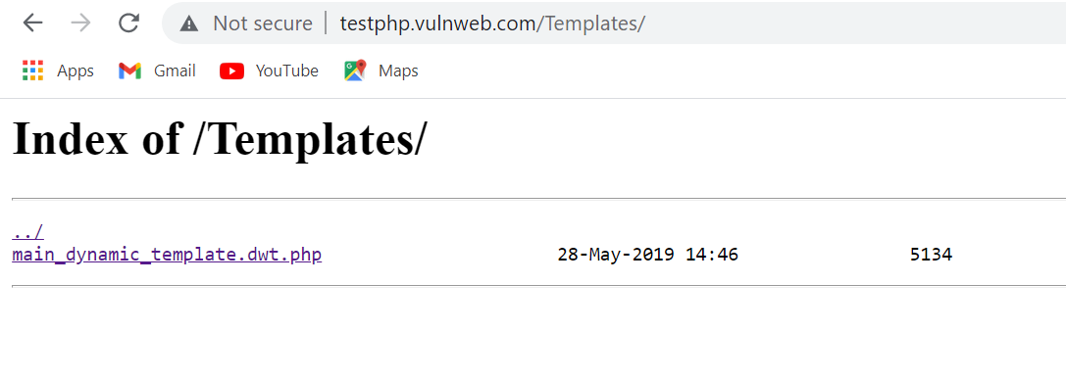
http://testphp.vulnweb.com/CVS/
Browsable Web Directories
Vulnerability Detection Report:
http://testphp.vulnweb.com/CVS/
http://testphp.vulnweb.com/Templates/

Slide 69
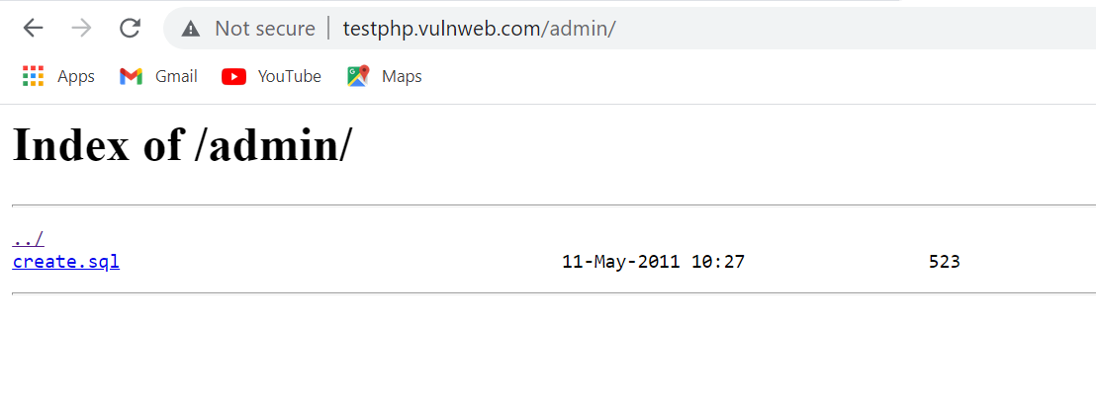
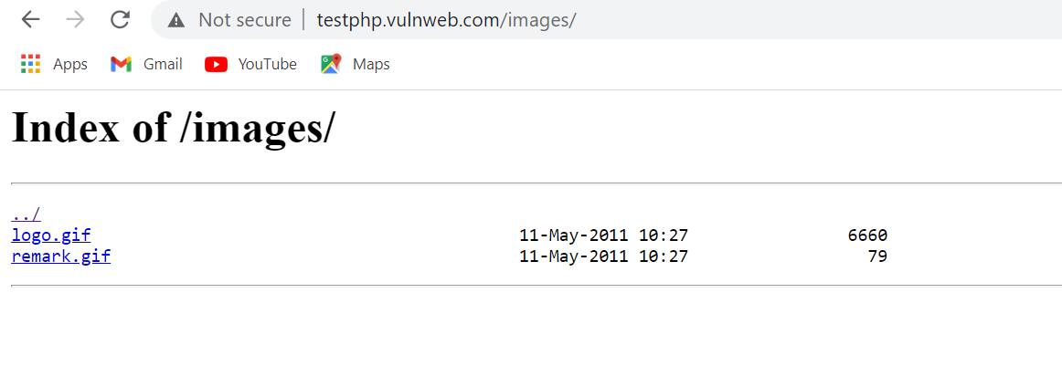
Vulnerability Detection Report:
http://testphp.vulnweb.com/admin/
http://testphp.vulnweb.com/images/

Slide 70
Web Server Transmits Cleartext Credentials
Observation:
The remote web server contains several HTML form fields containing an input of type 'password' which transmit their information to a remote web server in cleartext.
RISK: |  | High |  | Medium |  |  | Low
An attacker eavesdropping the traffic between web browser and server may obtain logins and passwords of valid users.
RECOMMENDATION:
Make sure that every sensitive form transmits content over HTTPS.
 |  |  |  |  | AFFECTED DEVICE:
.

Slide 71
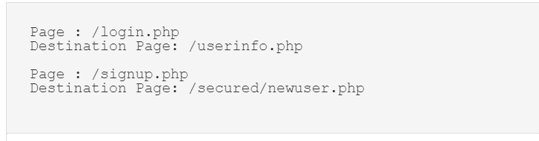
Web Server Transmits Cleartext Credentials
Vulnerability Detection Report:

Slide 72
Password Cracking and Decoding

Slide 73
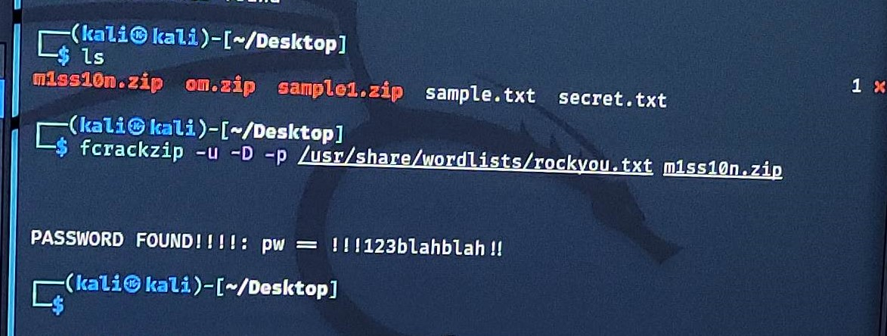
Cracked Password of zip file from website
www.varunpathak.in/m1ss10n.zip
PASSWORD Found:
!!!123blahblah!!

Slide 74


Decoding the password of pass.txt
Hashes has been cracked!!
Username and Password
Username : root
Password : kali
Username : kali
Password : kali
Username : varun
Password : !@#$%^6

Slide 75
Hiding Video behind Image

Slide 76

METHOD:
STEP1:
STEP2:
First select the video and image that you want to hide video behind the image. Select the location from where you want to merge the video and image. Keep ready that video and image on that location .
Make the zipped folder of that video by just right click on video then click Send to ->Compressed(zipped)folder. Zipped file will be created.

Slide 77

STEP3:
STEP4:
Then type the following Command:
copy \b image name.jpg+video name.zip foldername.jpg
Then the combined file will be save at that location.
Open COMMAND PROMPT(CMD) and checked the desired location of files.

Slide 78



STEP5:
STEP6:
Then open the archive file , then select the folder in it then you will able to access to the Hide Video.
To check able that we are able to hide a video behind that image, then just right click on the merged photo and SELECT ADD TO ARCHIVE. Then a new file will get created on same location.

Slide 79

THANK YOU
BY- SOHAN SUDHIR CHIDRAWAR
Notes:
https://www.freepik.com/free-photo/business-corporate-protection-safety-security-concept_3533269.htm#page=1&query=cyber%20security&position=0

